Slide 1

Introduction to Real-Time Shading with Many Lights
Ola Olsson
Chalmers University of Technology
Notes:
The first part then is going to be presented by me.
In this part we will provide an overview of techniques that have been, and still are, used in real-time shading.
The main focus will be on clustered shading, as this is the most advanced and efficient technique today...
…and is what the remaining talks in this course build on.

Slide 2


Clustered Shading
Clustered Shading
  High efficiency
  Flexible / Orthogonal
  Robust performance
  Validated in industry
    Avalanche (Just Cause 3)
    Playground Games (Forza Horizon 2)
    Intel (Demo/Presentation [Fauconneau14])
    AMD (Presentation [Thomas15])
  Wide platform support
    Discrete / Mobile GPU
Notes:
So why are we giving a course centered on clustered shading?
The reason is that is a technique with many good properties
and one that is gaining acceptance and support in the industry.
There are at least one shipped AAA title and one on the way
And I thought it would be interesting to take a bit of a census from the audience at this point
Can we have a show of hands from everyone here who have got clustered shading implemented or are experimenting with it in their engine?
In any case I’m always interested to hear if you do.
We will now spend the rest of this morning sharing what we know about clustered shading in the hope that it will help someone!

Slide 3
Talk Outline
Problem Definition
  What, exactly, are you talking about!?!
Part 1: ’Ancient’ Shading Techniques
  Forward Shading
  Deferred Shading
Part 2: Modern Shading Techniques
  Tiled Deferred/Forward Shading
  Clustered Deferred/Forward Shading

Slide 4
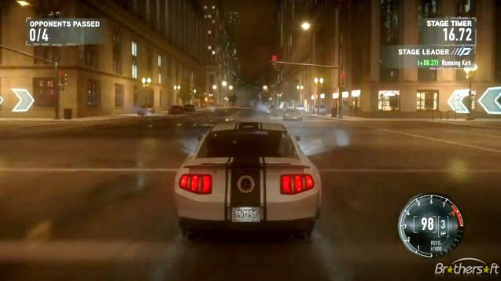
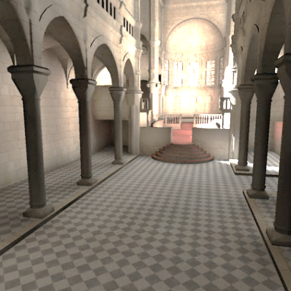
More Lights Please!
Need For Speed: The Run, ~2600 lights [Ferrier11]
Dynamic Lights
Complex Lights
Artistic Freedom
Global Illumination
Photon Splatting (Yao et al. 2010)
739k photons

Slide 5
Problem Definition
Real-time shading algorithms
  Thousands of lights
  Limited range light
  Fully dynamic
    Lights and Geometry
Influence = 0
Falloff
Light Range
Influence = 1
Notes:
The algorithms we are going to talk about are relevant when we target hundreds or thousands of lights in real time,
And in a way you could say that the end goal is to make the number a non-issue. <click>
The lights we consider have a limited range, with some falloff which goes to 0 at the boundary.
This means that lights are not physical, but this is (still) the normal procedure in games. <click>
We also do not consider shadows, which is covered later in the course.
There is no pre-computation so all geometry and lights are allowed to change freely from frame to frame.

Slide 6
Light Assignment – Not Shading!
Question:
  Which lights affect what shading point.
    2M pixels ×1k lights = enough
Goals:
  Minimize number of lights / pixel
  High performance
Solution:
  Light Assignment
  (Light Culling)
Notes:
Despite the name of all the techniques in this course, it is not actually about shading at all!
This is a name we have inherited from forward shading / deferred shading etc.
In reality the course is about working out which lights are relevant for shading each point of interest.
With millions of sample points (pixels) and thousands of lights
Doing this with high performance becomes sufficiently complex to be an interesting problem.
We call this process ‘light assignment’, but is also known as ‘light culling’.

Slide 7
Traditional Forward Shading
Part 1

Slide 8
(Traditional) Forward Shading
Rasterization:
Makes fragments,
Interpolates vertex data
The traditional approach
  Single pass
Rasterization generates
fragments
  Geometry samples
  Interpolated attributes
Each fragment is shaded
  Needs set of lights.
  Produces a color
Color
Normal
Position
Constants:
Lights
Materials
Shading
Frame buffer:
stores colors
Notes:
The traditional method for real-time shading is called forward shading and used to be the only method during the first decade, or so, of consumer GPUs.
It is still dominant on mobile hardware.
In this technique, there is only a single pass over the geometry drawing into a frame buffer accumulating the final image.
Geometry is rasterized, shading is performed and the frame buffer is updated.
Shading is performed in the fragment shaders. (Or indeed, in vertex shaders…)

Slide 9
Forward Shading
Which lights to use?
  Gather before draw call.
Want minimal set of lights.
  Small batches.
Want quick drawing
  Few batches!
    Large batches.
  Lower GPU/API overhead.
  Fewer material changes.
Notes:
Thus, we need to round up the set of relevant lights before each draw call.
and assign lights per chunk/batch of primitives.
To minimize number of lights, we want to make sure a batch is small, geometrically.
But to draw fast, keep the GPU busy and avoid API overhear, we want large batches.
And don’t care so much about geometric shape.
This is a fundamental conflict, where the best we can manage is a compromise. But it is a difficult one to strike.

Slide 10
Forward Shading Problems
Few large objects
Many small lights
Notes:
Now, this conflict runs deeper than simply batch size.
The basic problem is that we have to assign lights based on the size of geometry chunks.
Therefore, on the one hand, we might have a situation with a few large objects, and many small lights

Slide 11
Forward Shading - Problems
Few large objects
Many small lights
Redundant shading work
Notes:
This leads to lots of wasted effort in shading lights that only affect a portion of the geometry.

Slide 12
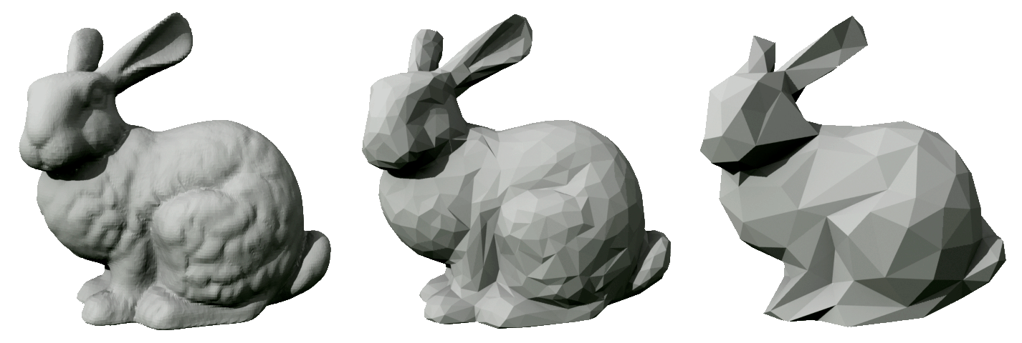
Forward Shading - Problems
Few large objects
Many small lights
Redundant shading work
Many small objects
Notes:
On the other hand, we may have many small objects.

Slide 13
Forward Shading - Problem Examples
Few large objects
Many small lights
Redundant shading work
Many small objects
Few large lights
Notes:
And a few large lights, <click>

Slide 14
Forward Shading - Problem Examples
Few large objects
Many small lights
Redundant shading work
Many small objects
Few large lights
Redundant light assignment work
Notes:
in which case we will spend a lot of effort to individually discover that they are affected by the same lights.

Slide 15
Forward Shading - Problem Examples
Few large objects
Many small lights
AND
Many small objects
Few large lights
Large triangles.
Varying light density (dynamic).
Notes:
So the conflict runs deeper than just batch size…<click>
And of course, in the same scene we might have both houses and rabbits, which means it is difficult or impossible to ensure a good performance balance.
Note that the large object could be a single triangle, and in general triangle size and varying light density makes this a very difficult problem to solve well.

Slide 16
Summary: Forward Shading
The good
The Bad
Single Pass
Low storage overhead
  Single Frame Buffer
Transparency works.
MSAA works
Simple if only few lights
  E.g., the sun
Varying shading models is easy.
Overdraw
Batching coupled with lighting
Shader management
  Permutations of #lights/type.
Notes:
To summarize, the main good thing about traditional forward shading is that

Slide 17
Summary: Forward Shading
The good
The Bad
Single Pass
Low storage overhead
  Single Frame Buffer
Transparency works.
MSAA works
Simple if only few lights
  E.g., the sun
Varying shading models is easy.
Overdraw
Batching coupled with lighting
Shader management
  Permutations of #lights/type.
Notes:
Everything can be done in a single pass with a single frame buffer, just storing the final color
This enables supporting transparency and MSAA without much ado.

Slide 18
Summary: Forward Shading
The good
The Bad
Single Pass
Low storage overhead
  Single Frame Buffer
Transparency works.
MSAA works
Simple if only few lights
  E.g., the sun
Varying shading models is easy.
Overdraw
Batching coupled with lighting
Shader management
  Permutations of #lights/type.
Notes:
Finally, we have that problem of assigning lights at the right granularity which makes an efficient implementation difficult.

Slide 19
Traditional Deferred Shading
Notes:
7 – 7:30

Slide 20
(Traditional) Deferred Shading
Goal:
  Decouple shading from geometric complexity
  Solve overdraw (shade once/sample)
Modern form introduced in 1990 [Saito90]
  Term coined later by Tebbs et al [Tebbs92]
  Consumer GPUs in 2004 [Hargreaves04]
  Games around 2005 [Shishkovtsov05]
Notes:
The basic goal is to solve both the overdraw problem and light assignment problem by decoupling geometry from shading.<click>
Deferred shading as we know it today with G-Buffers was introduced in 1990.
Although the term ‘deferred shading’ actually was coined later.
Started appearing in games around 2005, with the introduction of MRT.

Slide 21
Deferred Shading
Rasterization:
Makes fragments,
Interpolates vertex attributes
Key idea
  Defer shading
First do a geometry pass
  Sample geometry
  Interpolate attributes
  But, no shading
  Instead: G-buffers
Then do a shading pass
  Process lights independently.
  Shade only visible samples.
Color
Normal
Position
G-buffer(s):
stores attributes
Notes:
The key idea is to defer, that is wait with, the shading to its own pass.
So in a first pass, triangle geometry is transformed and sampled into fragments.
But instead of shading, the per-pixel geometry attributes are stored in what is called G-buffers.
The important thing is that they store all the attributes that can change per pixel.<click>

Slide 22
Deferred Shading
G-buffer(s):
stores attributes
Key idea
  Defer shading
First do a geometry pass
  Sample geometry
  Interpolate attributes
  But, no shading
  Instead: G-buffers
Then do a shading pass
  Process lights independently.
  Shade only visible samples.
Color
Normal
Position
Constants:
Lights
Materials
Shading
Frame buffer:
stores colors
Notes:
When all geometry has been processed a separate shading pass is performed.
And this pass is then independent of the scene geometry representation, and only works on the actually visible samples.

Slide 23
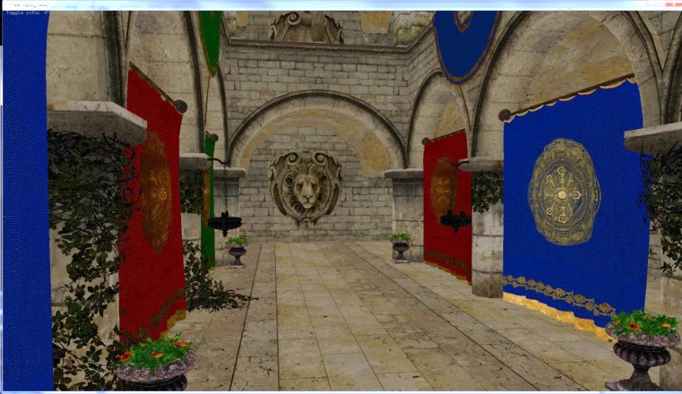
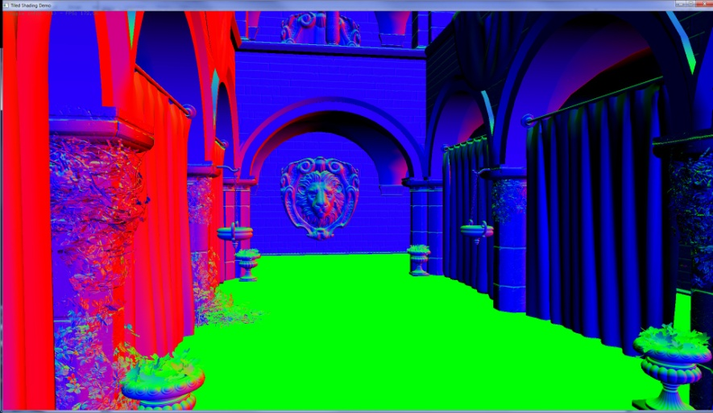
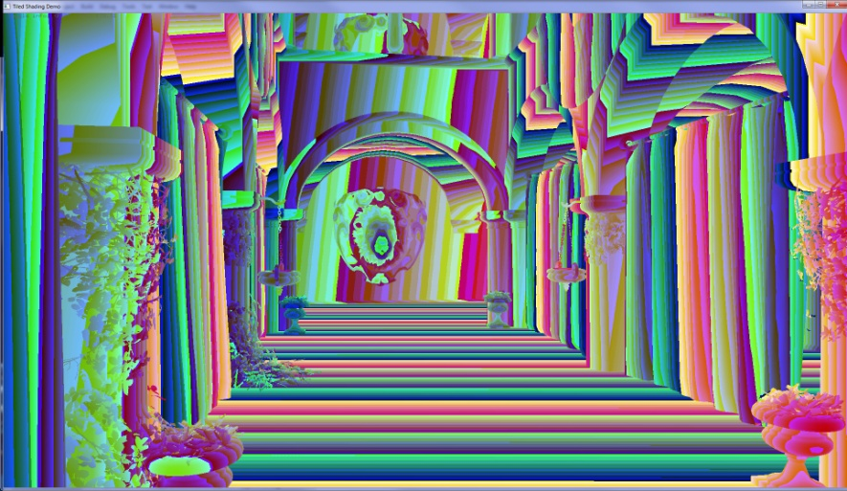
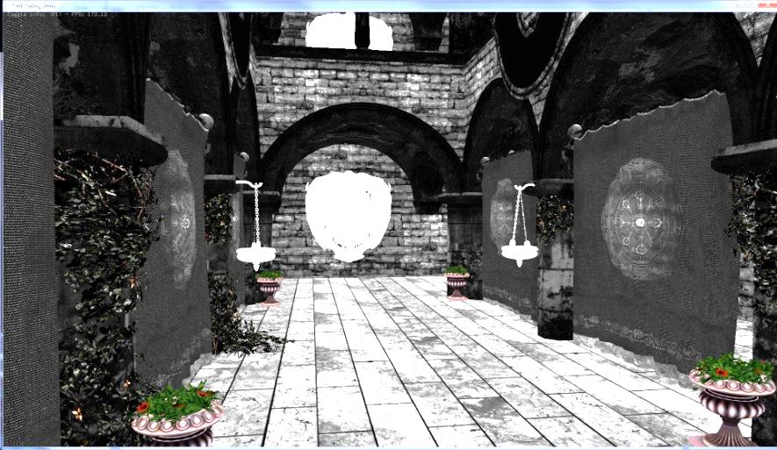
Geometry Pass: G-Buffers
Color
Normal
Position(Z)
Specular
Notes:
So a set of G-Buffers might look like this.
The important thing is that they store all the attributes that can change per pixel, and in addition a material ID can be used.

Slide 24
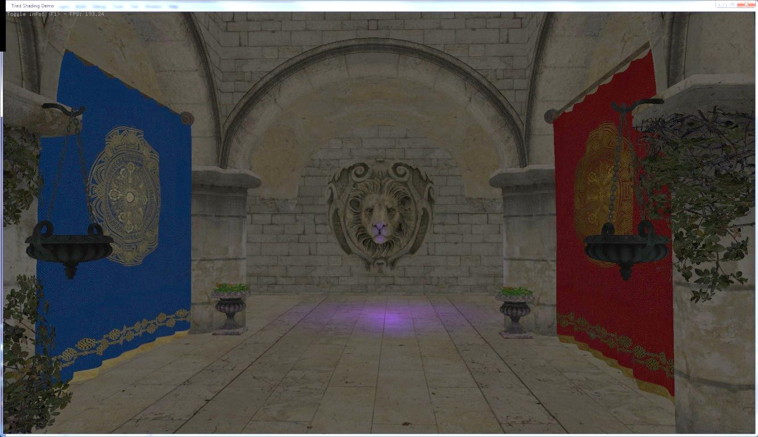
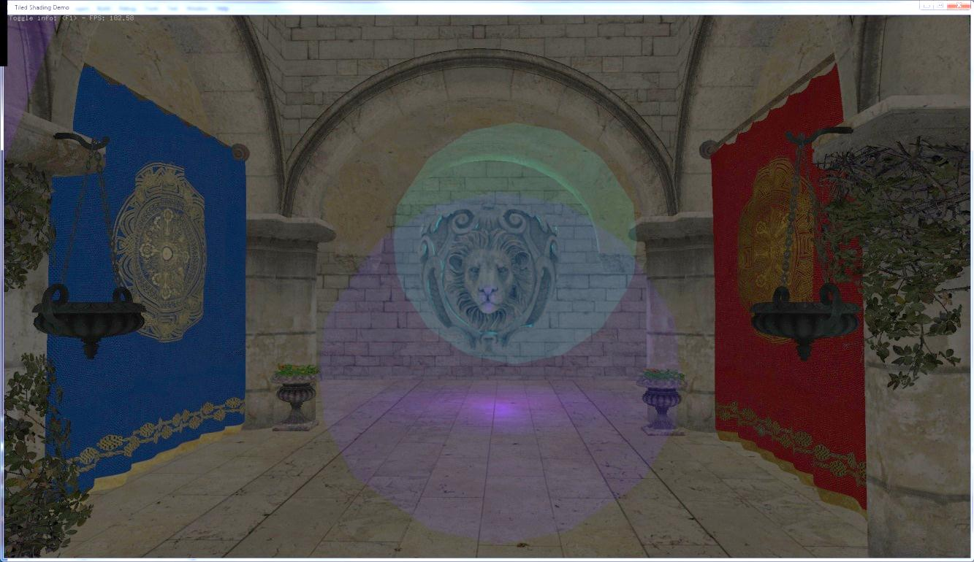
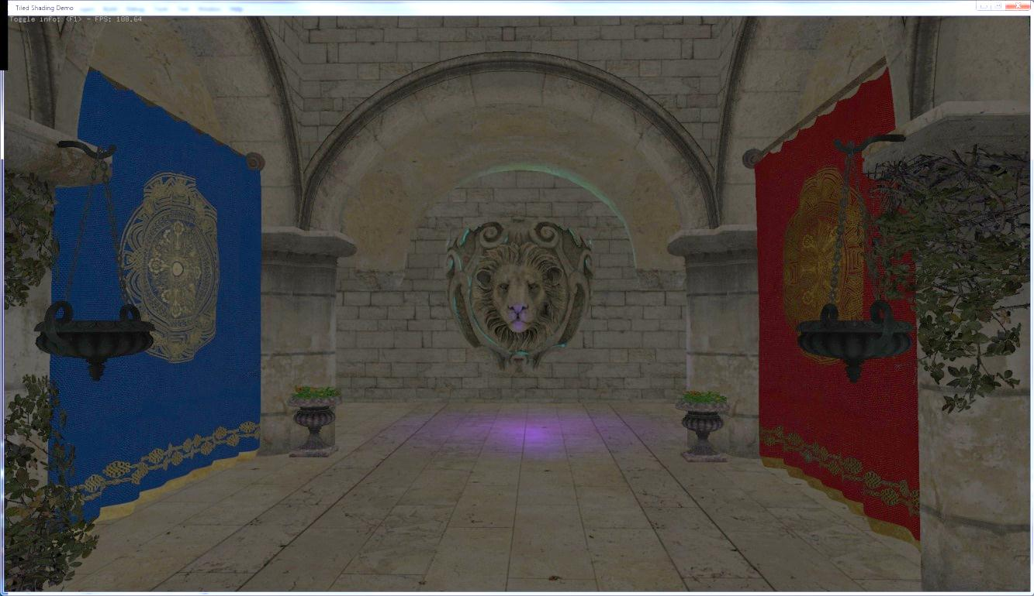
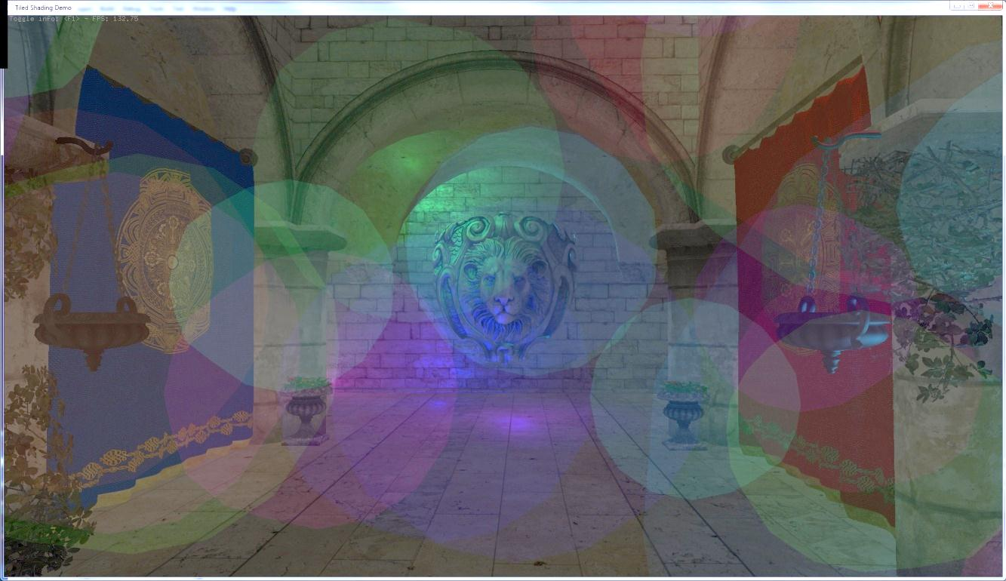
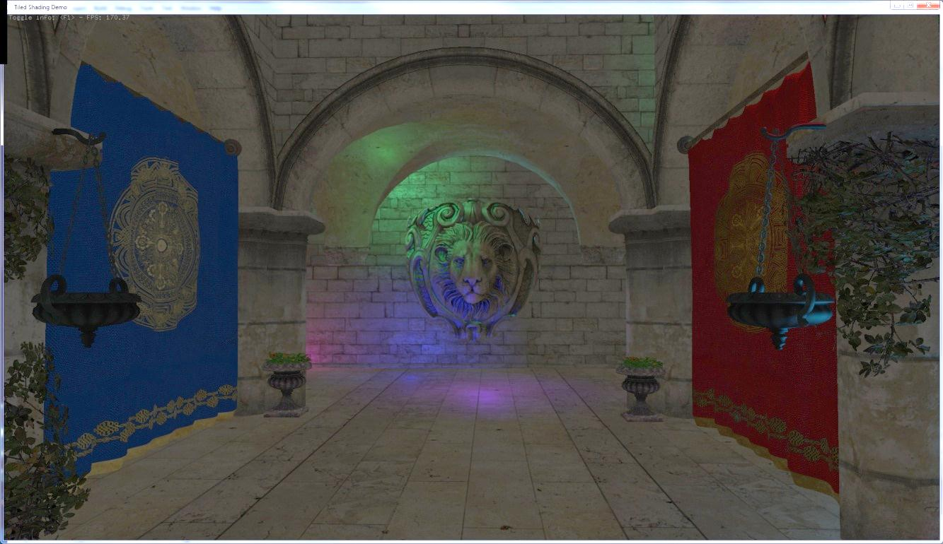
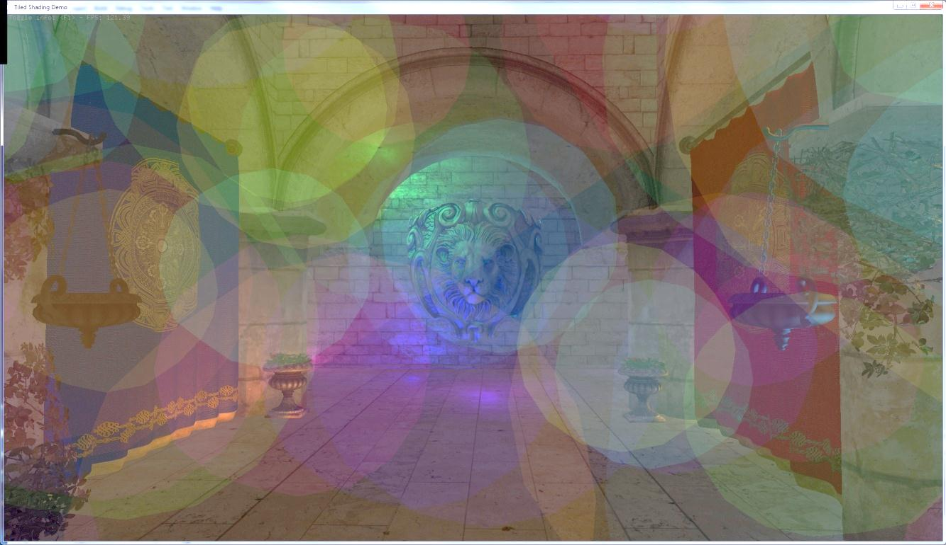
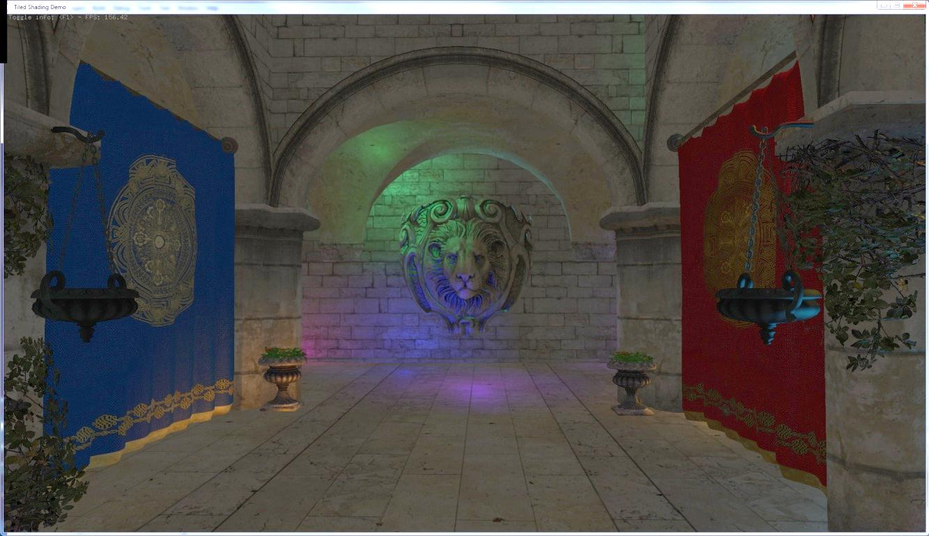
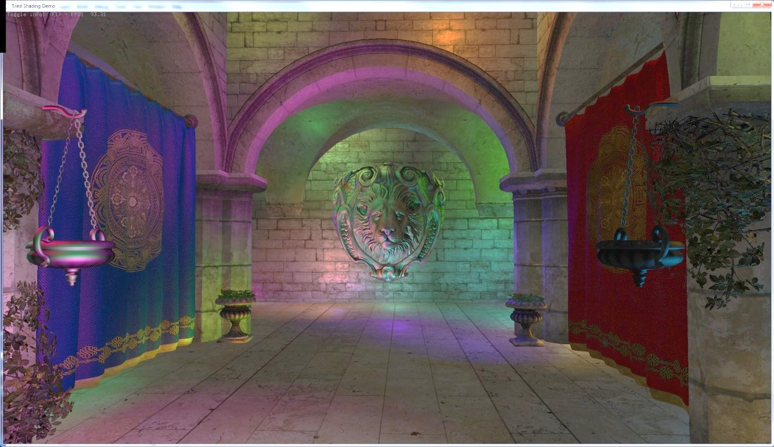
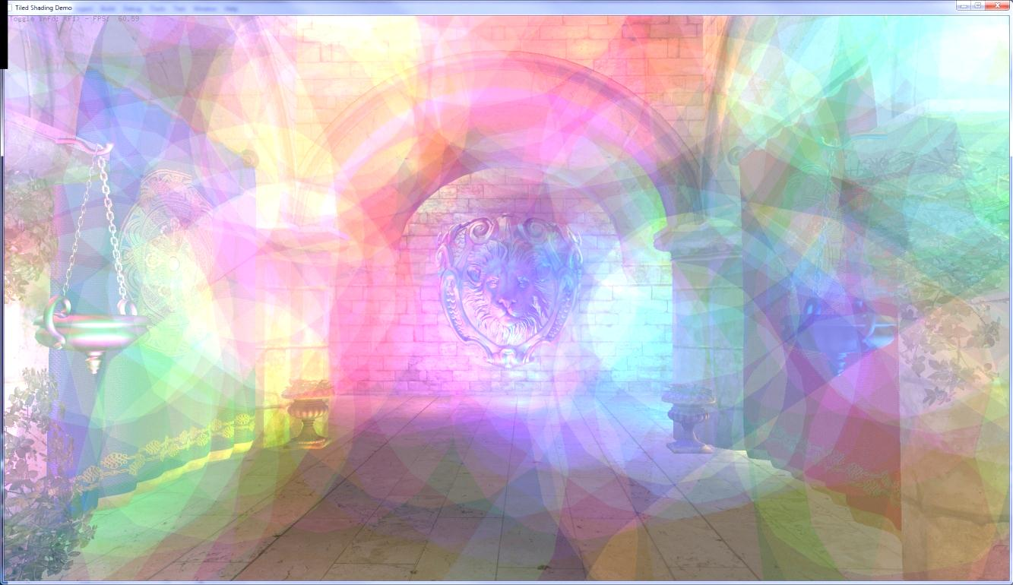

Shading Pass
For each light
  Draw Light Bounds
For each fragment
  Read G-Buffers
  Compute Shading
  Add to frame buffer
Notes:
The way we solve the light assignment is to use the rasterizer to draw the bounding volumes of each light <click> as geometry to the screen<click>
In the fragment shader of these we compute the shading.
Which is then blended into the frame buffer.
This is done independently for each light.

Slide 25
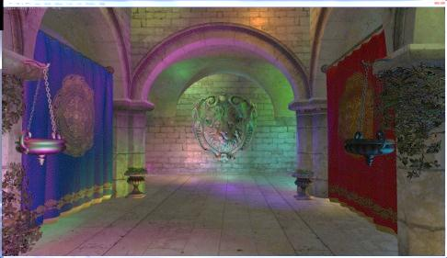
Deferred Light Shader
Color
Normal
uniform vec3 lightPosition;
uniform vec3 lightColor;
uniform float lightRange;
void main()
{
vec3 color = texelFetch(colorTex, gl_FragCoord.xy);
vec3 specular= texelFetch(specularTex, gl_FragCoord.xy);
vec3 normal = texelFetch(normalTex, gl_FragCoord.xy);
vec3 position = fetchPosition(gl_FragCoord.xy);
vec3 shading = doLight(position, normal, color,
specular, lightPosition,
lightColor, lightRange);
resultColor = vec4(shading, 1.0);
}
Position(Z)
Specular
Notes:
Here is a somewhat simplified light shader.
So this is a fragment shader that is used when drawing a light.
It is thusly executed once for each pixel covered by the light bounding sphere.
The shader has as uniform parameters the light attributes, position etc, these are the same for each fragment.
First all attributes are fetched from the G-Buffers.
Note that the screen space coordinate of the fragment is in gl_FragCoord.xy
Then shading is computed using these and the uniform attributes of the light.
And output to the color of the pixel.

Slide 26
Stencil Buffer Optimization [Arvo03]
Analogous to stencil shadows.
Draw light volume twice.
  First back faces.
    Set stencil mask on depth fail.
  Then front faces.
    Test stencil mask.
    Compute shading.
View Direction

Slide 27
Stencil Buffer Optimization [Arvo03]
Analogous to stencil shadows.
Draw light volume twice.
  First back faces.
    Set stencil mask on depth fail.
  Then front faces.
    Test stencil mask.
    Compute shading.
View Direction

Slide 28
Stencil Buffer Optimization [Arvo03]
Analogous to stencil shadows.
Draw light volume twice.
  First back faces.
    Set stencil mask on depth fail.
  Then front faces.
    Test stencil mask.
    Compute shading.
View Direction

Slide 29
Stencil Buffer Optimization [Arvo03]
Analogous to stencil shadows.
Draw light volume twice.
  First back faces.
    Set stencil mask on depth fail.
  Then front faces.
    Test stencil mask.
    Compute shading.
View Direction

Slide 30
Stencil Buffer Optimization [Arvo03]
Analogous to stencil shadows.
Draw light volume twice.
  First back faces.
    Set stencil mask on depth fail.
  Then front faces.
    Test stencil mask.
    Compute shading.
View Direction
Notes:
A very important optimization is using the stencil buffer to exclude any pixels that are outside the light volume.
This improves efficiency by only shading exactly those pixels that are needed.
It is however unclear if it can be efficiently implemented on modern hardware for many lights.

Slide 31
Other Variants
Deferred Lighting
  Factor out specular and diffuse color
  G-Buffer only store normal and shininess
  Output diffuse and specular shading
  Second geometry pass which multiplies colors
Light PrePass
  Much like the above
  But with monochromatic specular highlight
Similar performance as deferred
  Only improves constant factors.
Limits shading model even further

Slide 32
Summary: Trad. Deferred Shading
The good
The Bad
Trivial light management
  Enables many lights
Simple (light) shader management
High Shading efficiency
  Only shade lit samples
No overdraw
Single geometry pass
Shadow map reuse
No transparency
Large frame buffer
  Especially with MSAA
  Accumulates light in frame buffer
    High precision needed
Difficult to do multiple shading models
  Custom shaders
High memory bandwidth usage
Notes:
The large advantages are, especially when the technique was introduced,
Trivial light management, you just cull and draw the light bounds,
And light shaders only need to support one light type.

Slide 33
Summary: Trad. Deferred Shading
The good
The Bad
Trivial light management
  Enables many lights
Simple (light) shader management
High Shading efficiency
  Only shade lit samples
No overdraw
Single geometry pass
Shadow map reuse
No transparency
Large frame buffer
  Especially with MSAA
  Accumulates light in frame buffer
    High precision needed
Difficult to do multiple shading models
  Custom shaders
High memory bandwidth usage
Notes:
The large advantages are
Efficiency is very high, in that only samples that are actually affected by lights need to be shaded.

Slide 34
Summary: Trad. Deferred Shading
The good
The Bad
Trivial light management
  Enables many lights
Simple (light) shader management
High Shading efficiency
  Only shade lit samples
No overdraw
Single geometry pass
Shadow map reuse
No transparency
Large frame buffer
  Especially with MSAA
  Accumulates light in frame buffer
    High precision needed
Difficult to do multiple shading models
  Custom shaders
High memory bandwidth usage
Notes:
On the down side,
Transparency is not readily supported

Slide 35
Summary: Trad. Deferred Shading
The good
The Bad
Trivial light management
  Enables many lights
Simple (light) shader management
High Shading efficiency
  Only shade lit samples
No overdraw
Single geometry pass
Shadow map reuse
No transparency
Large frame buffer
  Especially with MSAA
  Accumulates light in frame buffer
    High precision needed
Difficult to do multiple shading models
  Custom shaders
High memory bandwidth usage
Notes:
On the down side,
We get very large frame buffers, especially with MSAA
And because we need higher precision for light accumulation.

Slide 36
Summary: Trad. Deferred Shading
The good
The Bad
Trivial light management
  Enables many lights
Simple (light) shader management
High Shading efficiency
  Only shade lit samples
No overdraw
Single geometry pass
Shadow map reuse
No transparency
Large frame buffer
  Especially with MSAA
  Accumulates light in frame buffer
    High precision needed
Difficult to do multiple shading models
  Custom shaders
High memory bandwidth usage
Notes:
On the down side,
It is more difficult to do custom shaders for certain geometry.

Slide 37
Summary: Trad. Deferred Shading
The good
The Bad
Trivial light management
  Enables many lights
Simple (light) shader management
High Shading efficiency
  Only shade lit samples
No overdraw
Single geometry pass
Shadow map reuse
No transparency
Large frame buffer
  Especially with MSAA
  Accumulates light in frame buffer
    High precision needed
Difficult to do multiple shading models
  Custom shaders
High memory bandwidth usage
Notes:
There are many other pros and cons, but we’ll focus on the most problematic:
High memory bandwidth requirements,

Slide 38
Modern Shading Techniques
Part 2
Notes:
This last problem brings us to the topic of modern shading techniques, so we’ll look into this in some more detail.
~11:45

Slide 39
GPU Performance Trends
2
2
2
2
2
2
2
2
Notes:
The graph shows the relative performance trends of top NVIDIA GPUs over 10 years
Showing clear exponential growth in both compute and bandwidth…

Slide 40
GPU Performance Trends
≈ 100X
2
2
Mind the Gap!
2
2
2
≈10X
2
2
2
Notes:
Note, however, the difference in exponent!<click>
Over the 10 years plotted that amounts to a difference of a factor 10.<click>…
…for a compute versus memory bound algorithm.
So, aiming for compute bound is key in future proofing your algorithms.

Slide 41
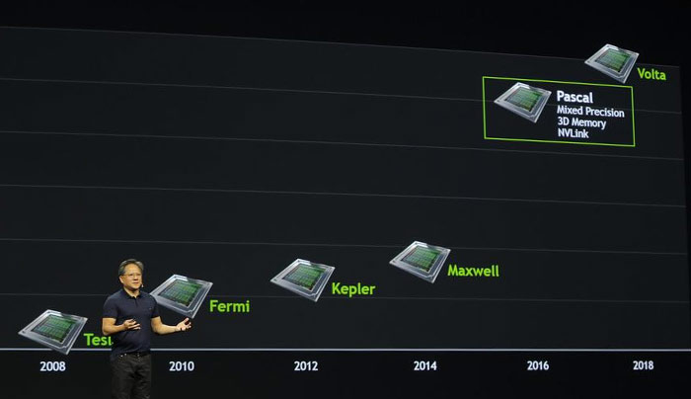
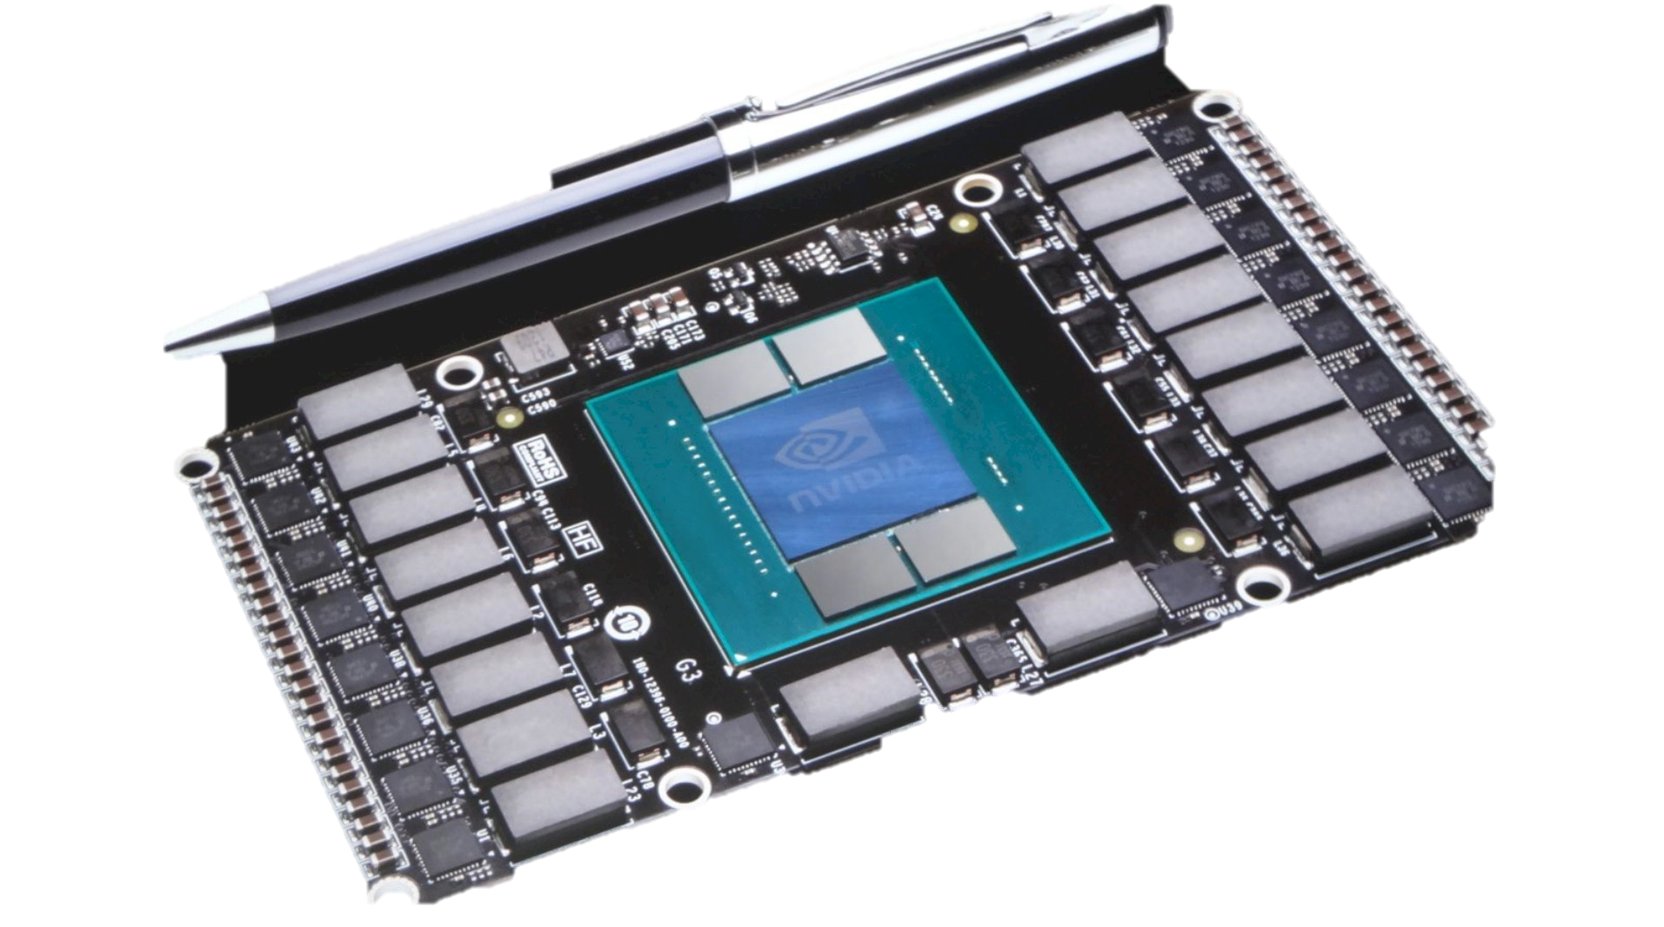
But!
3D Memory!
HBM!
Pascal!
Solve Bandwidth problems!
Transformational!
Revolutionary!
New Applications!
Ice cream for everyone!

Slide 43
Notes:
Adding predicted architectures
Speculative 10 core Broadwell-E (same architecture as haswell + 2 cores)
Speculative Pascal (Promised 1 TB/s bw and less than 2x compute)

Slide 44
Modern Shading Techniques
Observations:
  GPU Compute >> Bandwidth
  Better GPU general purpose capability
Conclusion:
  Explore alternatives to rasterization!
    When it makes sense…
Broad impact
  Many algorithms forced triangles!
    Shadow volumes
    Various splatting algorithms
Notes:
With this, modern approaches to real-time shading with many lights all take their in the following 2 observations
First, as we just saw compute is king.
Second, the GPU general purpose programming models and power of these cores has improved tremendously over the last years.
These observations have broad impact because not long ago triangle rasterization was the only game in town if you wanted real-time performance.
This means that we are now sometimes stuck with a way of doing things that is no longer suitable.
Thus I think the field is open to revisit many real-time algorithms with this frame of mind.

Slide 45
The Bandwidth problem
New type of overdraw
  Light overdraw
N lights cover a certain pixel ->
  N reads from the same G-Buffer location
for each light
for each covered pixel
read G-Buffer
compute shading
read + write frame buffer
Notes:
Tiled and Clustered shading are examples of this, and it brings us back to the bandwidth problem of traditional deferred.
As we are now drawing the lights, in the shading pass, we have overdraw when many lights overlap the same pixel.
Schematically deferred shading looks like this, we iterate over each light,
and then in parallel, by drawing the bounding volume, over all the fragments.

Slide 46
The Bandwidth problem
for each light
for each covered pixel
read G-Buffer
compute shading
read + write frame buffer
Repeated reads
and writes
Notes:
The problem is from the fact that the innermost loop is over the pixels,
This which requires repeated reading, and writing of the G-Buffers and frame buffer.

Slide 47
The Bandwidth problem
for each light
for each covered pixel
read G-Buffer
compute shading
read + write frame buffer
Re-write loop!
Hoist read/write
outside.
Re-order loops
Load/store -> Outer loop
for each pixel
read G-Buffer
for each affecting light
compute shading
write frame buffer
Notes:
So we want to re-arrange this loop to make the innermost loop iterate over the lights instead. .<click>
Then we get this nice compute oriented loop.
With a single read and write which would solve the bandwidth problem.

Slide 48
The Bandwidth problem
for each pixel
read G-Buffer
for each affecting light
compute shading
write frame buffer
Requires
  sequential access
  to lights
Global list?
  Inefficient!
List per pixel? [Trebilco07]
  Slow construction ⬄ Shading
  Lots of data
Notes:
However, we now need to access all the relevant lights for each pixel sequentially.
Just using a global list of lights is of course terribly inefficient.
At the other end of the spectrum, creating lists of lights for each pixel individually is both slow and requires lots of storage.

Slide 49
The Modern shading solution
Share between groups of similar pixels
  Lots of coherency between samples
  Coherent access
  Little storage
  Conservative
  lists
for each pixel
read G-Buffer
for each possibly affecting light
if affecting
compute shading
write frame buffer
Notes:
The modern solution is instead to build list for groups of similar samples.
The motivation is of course that many pixels will use the same lights in a typical scenario
Allowing us to share the list over many samples.
Then list must be conservative, storing all lights that may affect any sample within the tile.
So we trade some compute performance for bandwidth,
which as we have seen is a pretty good gambit on modern GPUs.
But at the same time significantly closer to the optimum compared to brute force.

Slide 50
Modern Deferred Shading
1. Render Scene to G-Buffers
2. Light assignment
  Build Light Acceleration Structure (Grid)
3. Full Screen Pass
  Quad (or CUDA, or Compute Shaders, or SPUs)
  For each pixel
    Fetch G-Buffer Data
    Look up light list in acceleration structure.
    Loop over lights and accumulate shading
    Write shading

Slide 51
Modern Forward Shading
(1. Optional: Pre-Z/Geometry Pass)
2. Light assignment
  Build Light Acceleration Structure (Grid)
3. Geometry Pass
  Just your normal shading pass.
  For each fragment
    Look up light list in acceleration structure.
    Loop over lights and accumulate shading
    Write shading to frame buffer

Slide 52
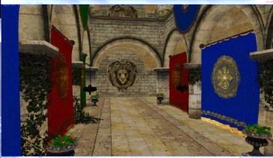
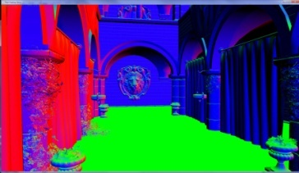

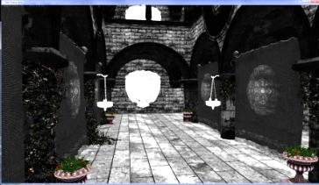
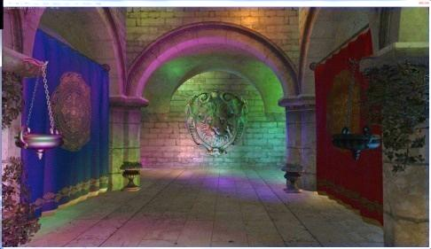
Full-Screen Modern Shading Pass
Color
Normal
Light Grid:
L₀
L₁
L₂
L₃
L₄
L₅
L₆
…
0
0
6
3
0
6
4
4
…
Position(Z)
Specular
out vec4 resultColor;
void main()
{
vec3 color = texelFetch(colorTex, gl_FragCoord);
vec3 specular= texelFetch(specularTex, gl_FragCoord);
vec3 normal = texelFetch(normalTex, gl_FragCoord);
vec3 position = fetchPosition(gl_FragCoord);
vec3 shading = accumulate for each light in tile-list;
resultColor = vec4(shading, 1.0);
}
Light Grid:
0
1
4
7
offset
1
3
3
1
66
67
69
…
size
1
2
2
…
…
…

Slide 53
Tiled / Clustered Shading
Light Grid Provides
  Access to light list for each pixel
Light Grid building
  Is pretty quick
  CPU for hundreds of lights
Can support transparency
  Assign light in entire view volume

Slide 54
Summary: Modern Shading
The good
The Bad
Low bandwidth
Flexible
  Forward or Deferred
Transparency
MSAA
Complex light shader
  If multiple light types
No Shadow map reuse
Notes:
So, we have pretty much solved the bandwidth problem which is great,
It matters a lot less suddenly if the G-Buffers are fat as chips

Slide 55
Summary: Modern Shading
The good
The Bad
Low bandwidth
Flexible
  Forward or Deferred
Transparency
MSAA
Complex light shader
  If multiple light types
No Shadow map reuse
Notes:
The techniques are flexible, in that it is fairly trivial to support forward or deferred shading, or both.

Slide 56
Summary: Modern Shading
The good
The Bad
Low bandwidth
Flexible
  Forward or Deferred
Transparency
MSAA
Complex light shader
  If multiple light types
No Shadow map reuse
Notes:
Using forward, in turn, makes it possible to support transparent and MSAA.

Slide 57
Summary: Modern Shading
The good
The Bad
Low bandwidth
Flexible
  Forward or Deferred
Transparency
MSAA
Complex light shader
  If multiple light types
No Shadow map reuse
Notes:
On the down side, the light shader now must support all light types, which makes it more complex.
And since lights are not sequentially processed we cannot re-use shadow map storage space between lights.
More on this in my second talk!

Slide 58
Tiled Shading
Tiled Deferred, Tiled Forward (Forward+)
Notes:
This brings us to the first of the modern techniques that has been developed in this new, bandwidth constrained and compute oriented, landscape.
Collectively called Tiled Shading, it covers both deferred and forward variants,
The forward variant is also referred to as “Forward+” by AMD, presumably for marketing reasons.
~20 - 22

Slide 59
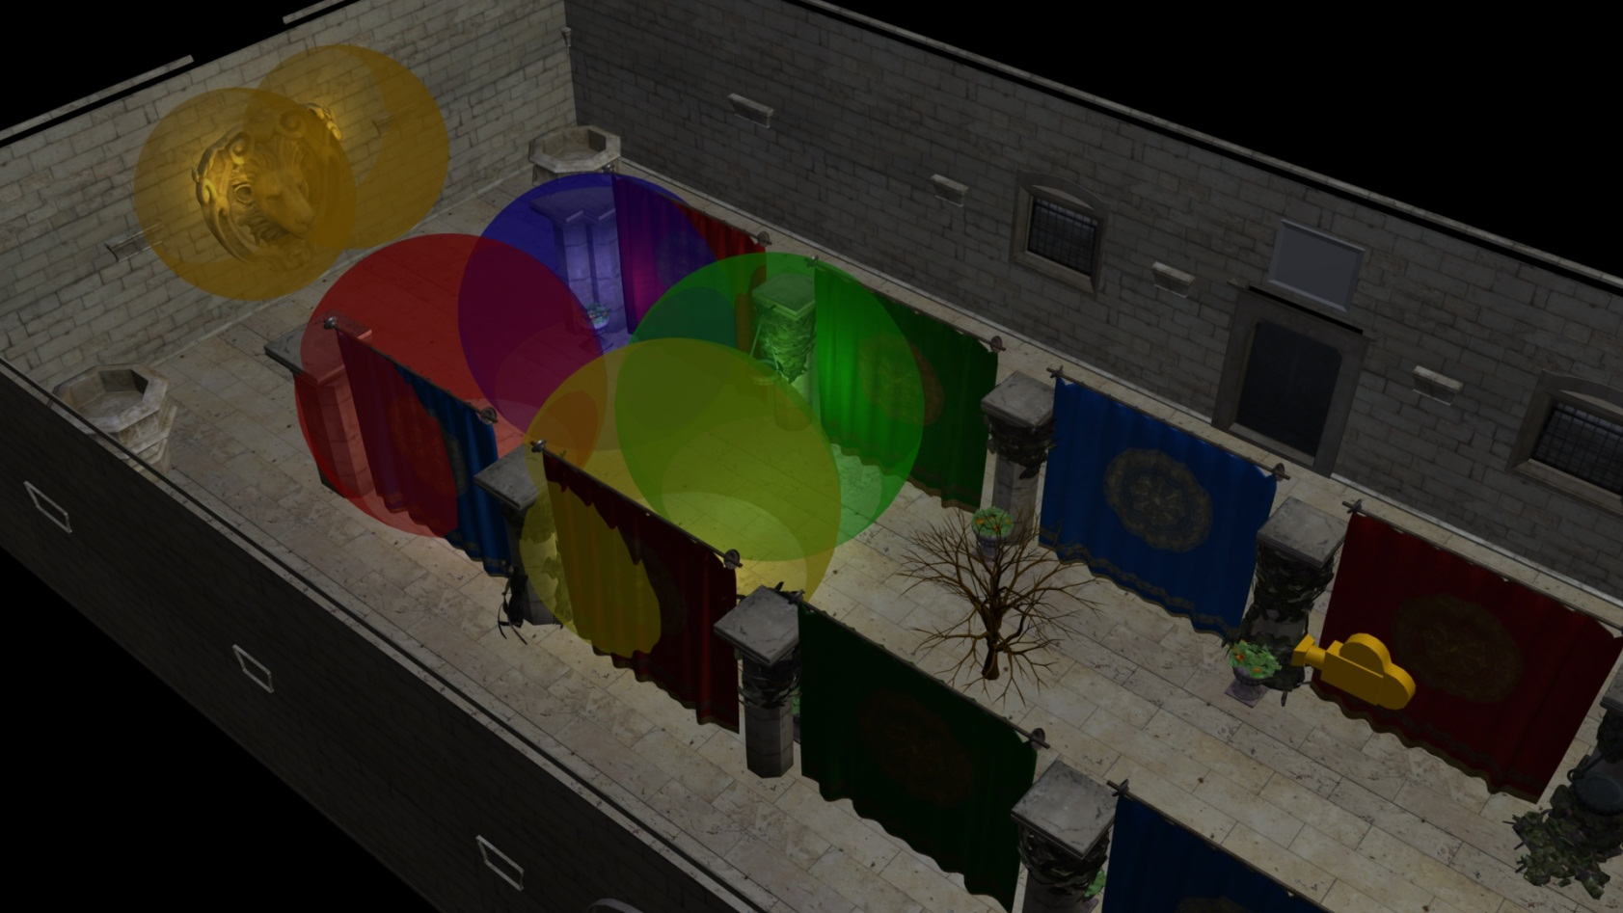
Example Scene
Crytek Sponza
  Minus top
6 Lights
A Tree
Notes:
We will be using this example scene to illustrate how tiled and clustered shading works.
The scene is the usual Crytek Sponza scene, but with the top three quarters lifted off, to let us get a better view.
I’ve added six lights of different colours, represented as spheres.
To make the view more interesting, I’ve also added a tree.

Slide 60
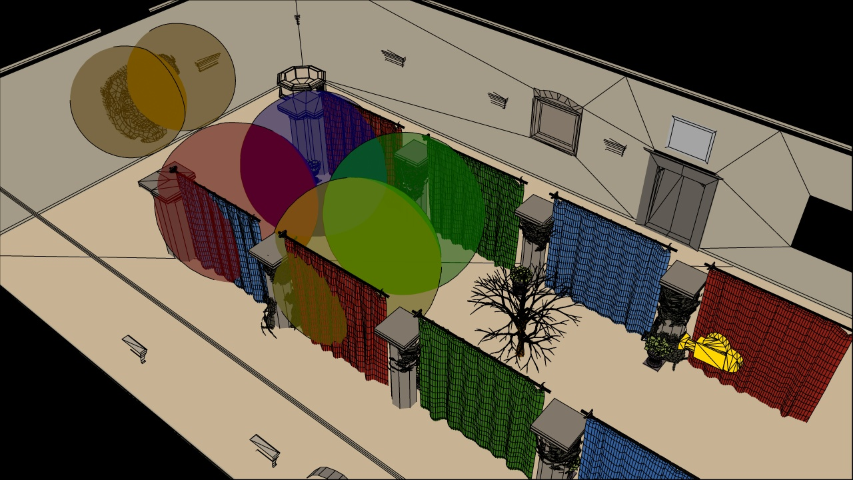
Example Scene
Crytek Sponza
  Minus top
6 Lights
A Tree
Notes:
The same view in outline mode, to make it more clear.

Slide 61
Example Scene
Crytek Sponza
  Minus top
6 Lights
A Tree
Notes:
This is the viewpoint that will be used to demonstrate the algorithms, the camera is looking through the tree towards the lion head on the wall.

Slide 62

Example Scene
Notes:
Shifting to the point of view of the yellow camera.

Slide 63
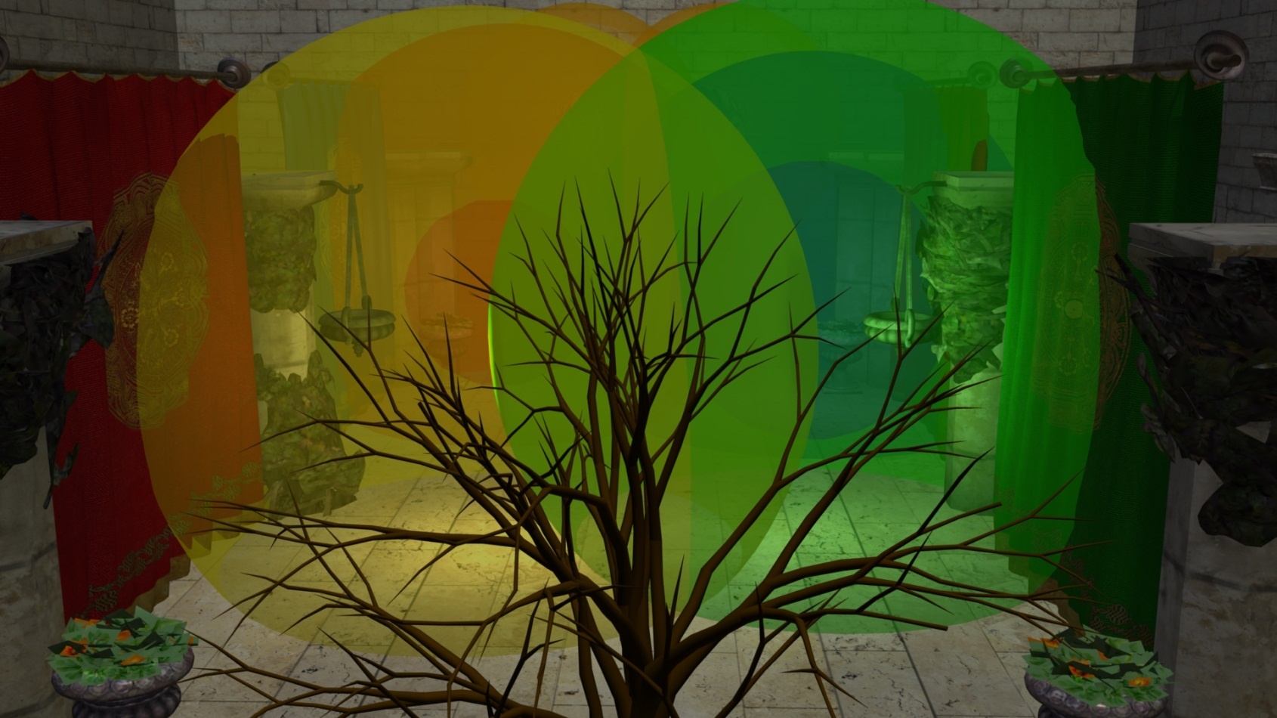
Tiled Shading Recap
Deferred or Forward*.
Simple.
Fast (sometimes).
2D
* Which AMD calls “Forward+”
Notes:
Now I will go into a re-cap of how tiled shading works.
Tiled shading can be implemented using either deferred of forward shading techniques, or a mix. Note that AMD insists on calling “Tiled Forward Shading”, “Forward+”, it is however identical.
For light assignment, it matters very little which form we use, so I will not go into specifics.
It is conceptually very simple, and also relatively easy to implement, at least in the simplest form.
Performance is good, given the right circumstances.
And fundamentally it is a 2D algorithm.

Slide 64
Tiled Shading Grid Construction
Screen space tiles
  E.g. 32x32 pixels
  Each contains list of lights
Notes:
The screen is divided into tiles, each covering say 32 by 32 pixels.
Each tile contains a single list of all the lights that might influence any of the pixels inside.
Note that this list is shared between the pixels, so overhead for list maintenance and fetching is low.

Slide 65
Tiled Shading Grid Construction
For each Light
  Find screen space AABB
Notes:
To construct the lists, we might do as follows.
For each light, establish the screen space bounding box, illustrated for the green light.

Slide 66
Tiled Shading Grid Construction
For each Light
  Find screen space AABB
  Add light to affected tiles
1
1
1
1
1
1
1
1
1
1
1
1
1
1
1
1
1
1
1
1
1
1
1
1
1
1
1
1
1
1
1
1
1
1
1
1
1
1
1
1
1
1
1
1
1
1
1
1
1
Notes:
Then add the index of the light to all of the overlapped tiles.

Slide 67
Tiled Shading Grid Construction
1
1
1
1
1
1
1
1
1
1
1
1
1
1
1
1
1
1
1
1
1
1
1
1
1
1
1
1
1
1
1
1
1
1
1
1
1
1
1
1
1
1
1
1
1
1
1
1
1
Notes:
Then repeat this process for all remaining lights.

Slide 68
Tiled Shading Grid Construction
1
1
1
1
2
2
2
2
1
1
1
1
1
1
1
2
2
2
2
1
1
1
1
1
1
1
2
2
2
2
1
1
1
1
1
1
1
2
2
2
2
1
1
1
1
1
1
1
2
2
2
2
1
1
1
1
1
1
1
2
2
2
2
1
1
1
1
1
1
1
2
2
2
2
1
1
1
1
1
1
1
1
1
1
1
Notes:
The illustration only shows the counts, so you need to imagine the lists being built as well.

Slide 69
Depth Range Optimization
Light
Z-min
Light
Z-max
Depth Range Optimization
  Min/Max depth per tile
  From Pre-z pass
For each Light
  Test depth bounds
Z-max
Y
Z-min
Z
Eye
near
Notes:
In practice we’d also do a conservative per-tile min/max depth test, to cull away lights occupying empty space.
Just like the stencil optimization for traditional deferred.
If we don’t do this performance generally goes down the toilet…
and this is what makes a pre-z pass necessary for tiled forward shading.

Slide 70
Tiled Shading Light Grid
Global Light List:
L₀
L₁
L₂
L₃
L₄
L₅
L₆
…
Tile Light Index Lists:
0
0
6
3
0
6
4
4
…
Light Grid:
0
1
4
7
1
3
3
1
offset
66
67
69
…
1
2
2
…
size
…
…
Notes:
After we have processed all the lights, we end up with a 2D grid such as this
This can then be used in the shading pass, as we saw before.

Slide 71
Tiled Shading
Light Grid Provides
  Access to light list for each pixel
  List shared within tile
    Low memory usage
    Good access coherency
    Not pixel exact
Light Grid building
  Is pretty quick
  CPU for hundreds of lights
    Depends more on overlap than number of lights

Slide 72
Summary: Tiled Shading
The good
The Bad
Low bandwidth
Simple light assignment
Trivial Light list lookup
High performance
Flexible
  Forward or Deferred
Transparency
MSAA
Complex light shader
No Shadow map reuse
View dependence
  2D light assignment
  Depth discontinuities
Notes:
To reiterate, we’ve solved the bandwidth problem

Slide 73
Summary: Tiled Shading
The good
The Bad
Low bandwidth
Simple light assignment
Trivial Light list lookup
High performance
Flexible
  Forward or Deferred
Transparency
MSAA
Complex light shader
No Shadow map reuse
View dependence
  2D light assignment
  Depth discontinuities
Notes:
Light assignment is quite simple, just a 2D operation and lookup just depends on screen space location!

Slide 74
Summary: Tiled Shading
The good
The Bad
Low bandwidth
Simple light assignment
Trivial Light list lookup
High performance
Flexible
  Forward or Deferred
Transparency
MSAA
Complex light shader
No Shadow map reuse
View dependence
  2D light assignment
  Depth discontinuities
Notes:
However, performance is strongly view dependent.
Which means run time performance is not readily predictable from scene parameters such as light distribution.
We’ll look into this problem in some detail next…

Slide 75
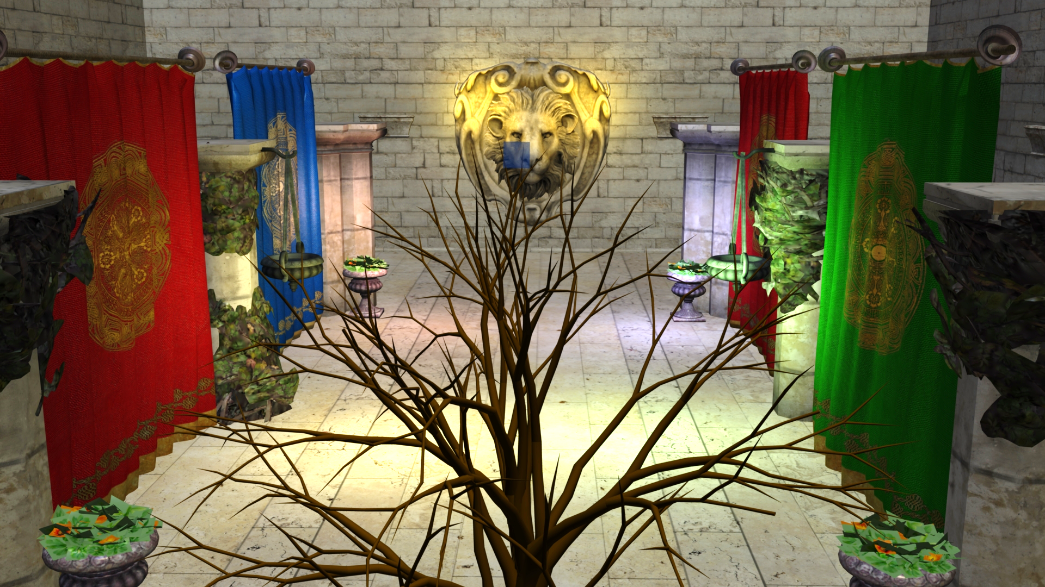
Tiled Shading Problems
Notes:
Here’s that view again…

Slide 76
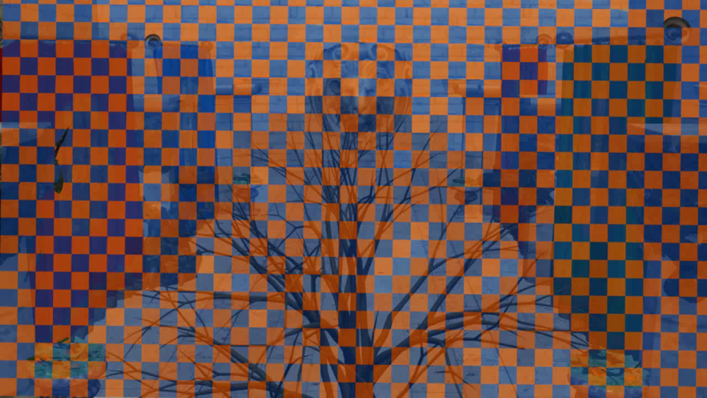
Tiled Shading Problems
Notes:
And here are the tiles, pulled from our implementation…

Slide 77
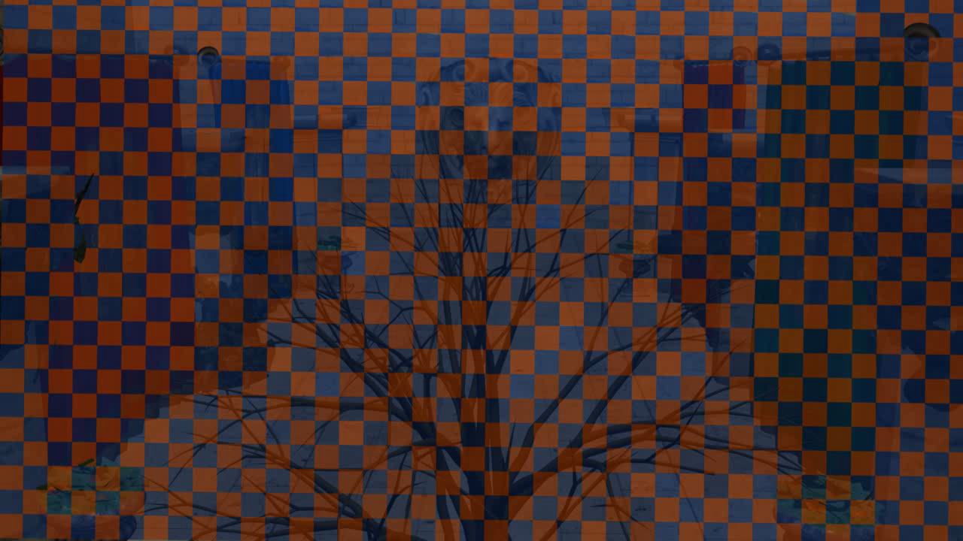
Tiled Shading Problems
Notes:
Switching to the overhead view, we see how they extend from the tree over to the background geometry.

Slide 78
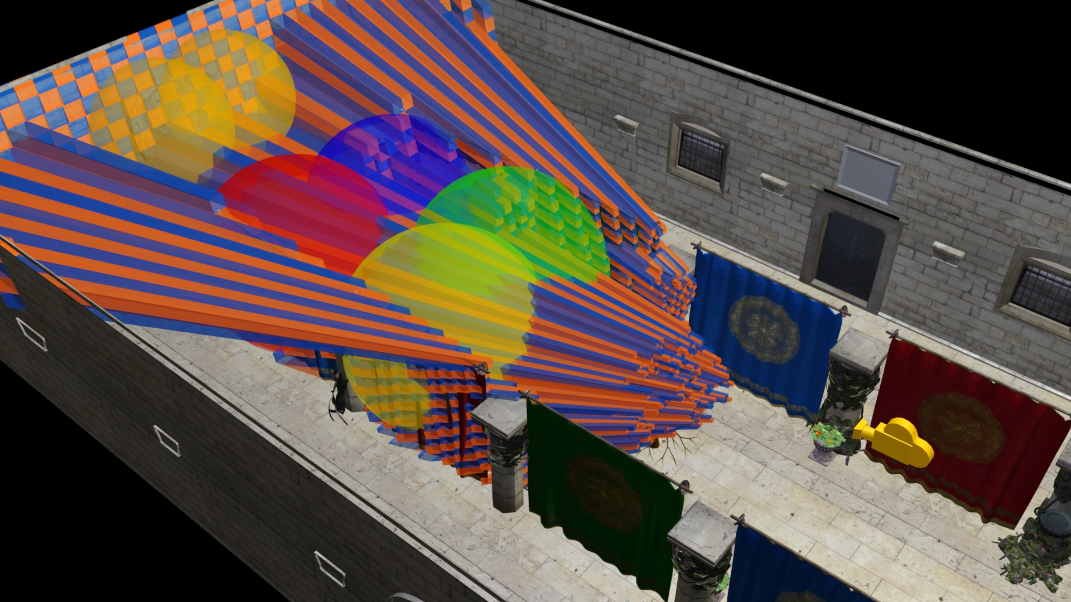
Tiled Shading Problems
Tiles – 2D
Games – 3D
  Hmm…
Notes:
Toggling on the light geometry, we see that there is a lot of overlap…
…even in the empty space behind the tree.
We now should be able to start seeing the shape of the problem with 2D tiles in a 3D world.

Slide 79
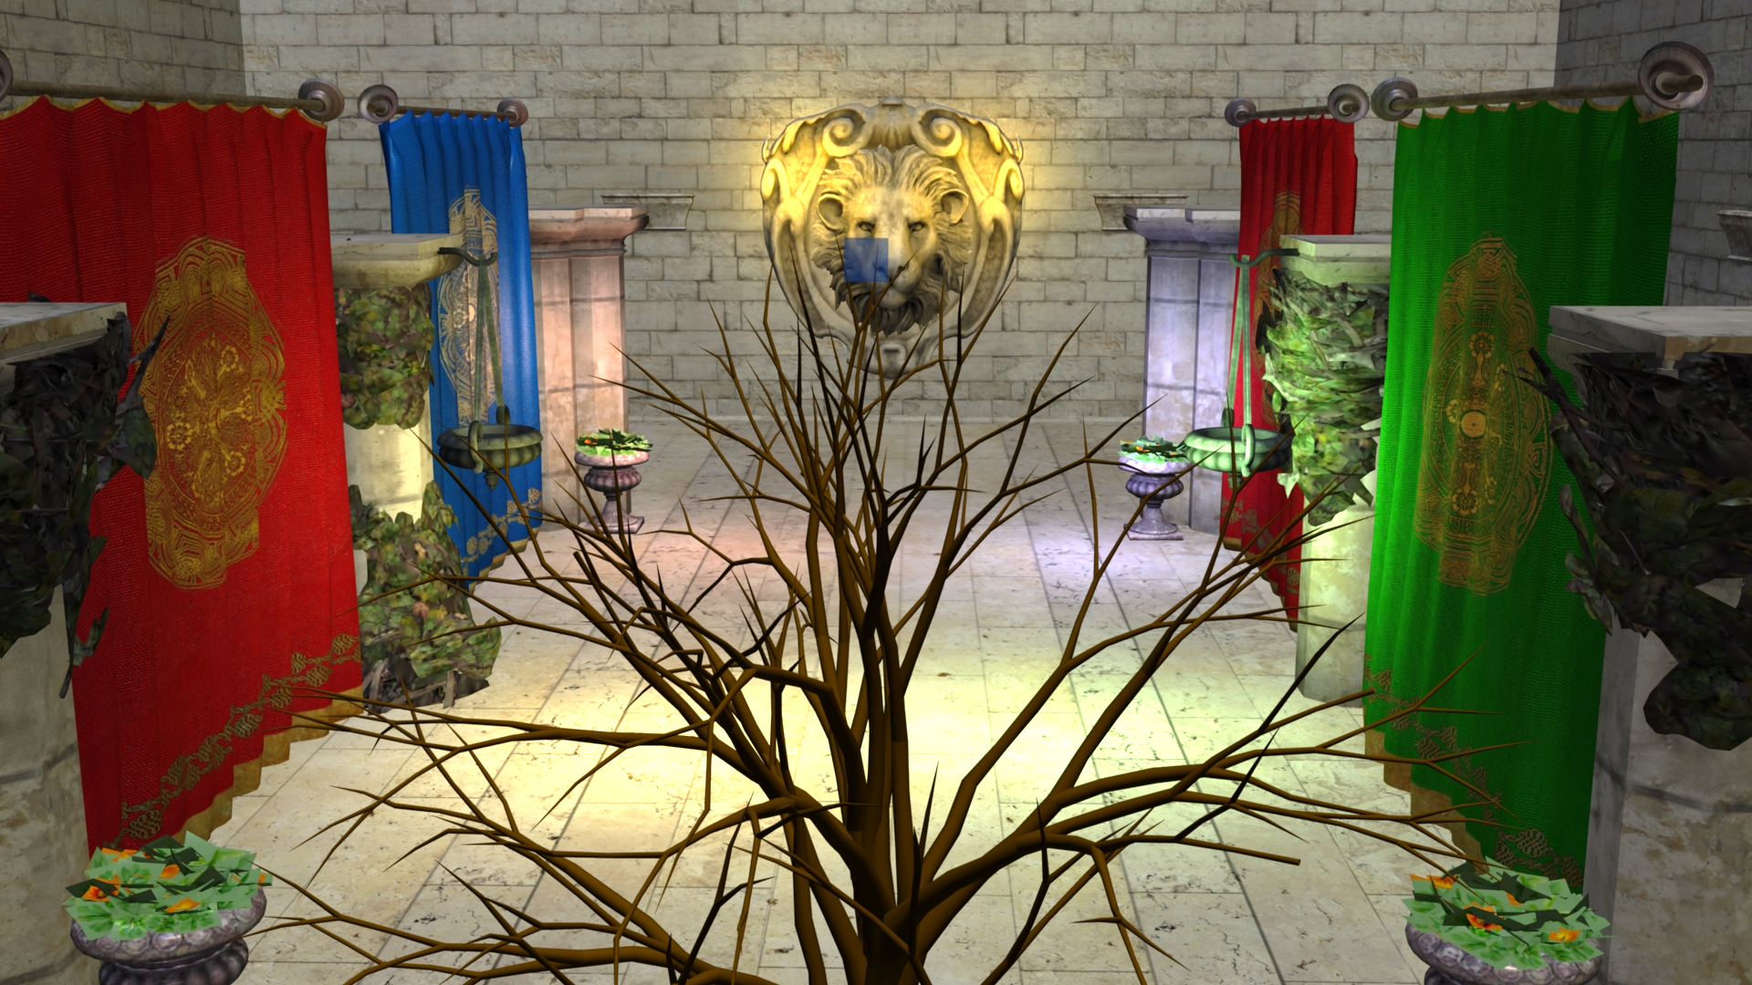
Tiled Shading
Single Tile
Notes:
We’ll now take a closer look at a single tile, in order to highlight the problem.

Slide 80
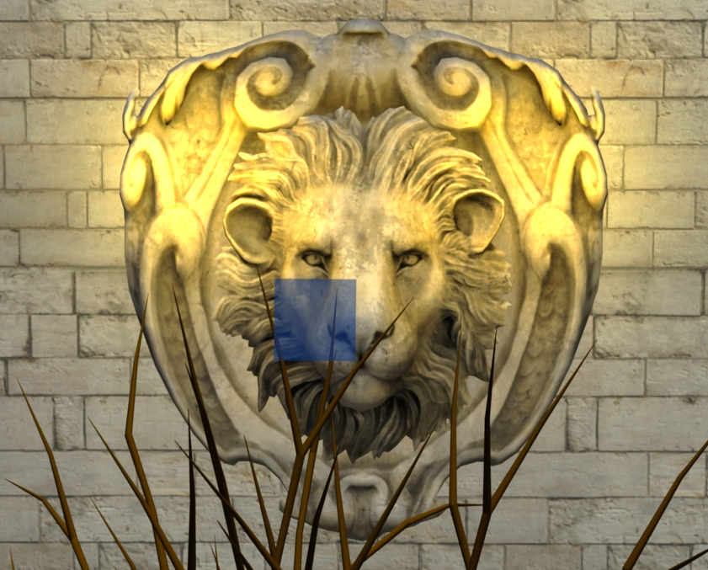
Tiled Shading
Single Tile

Slide 81
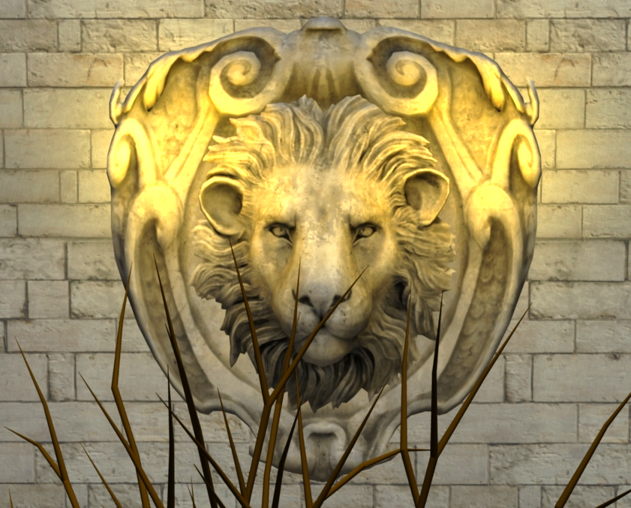
Tiled Shading
Single Tile
Notes:
As we can see, there is a small number of samples from the tree
And the rest, the lion share of the pixels are in the background.

Slide 82
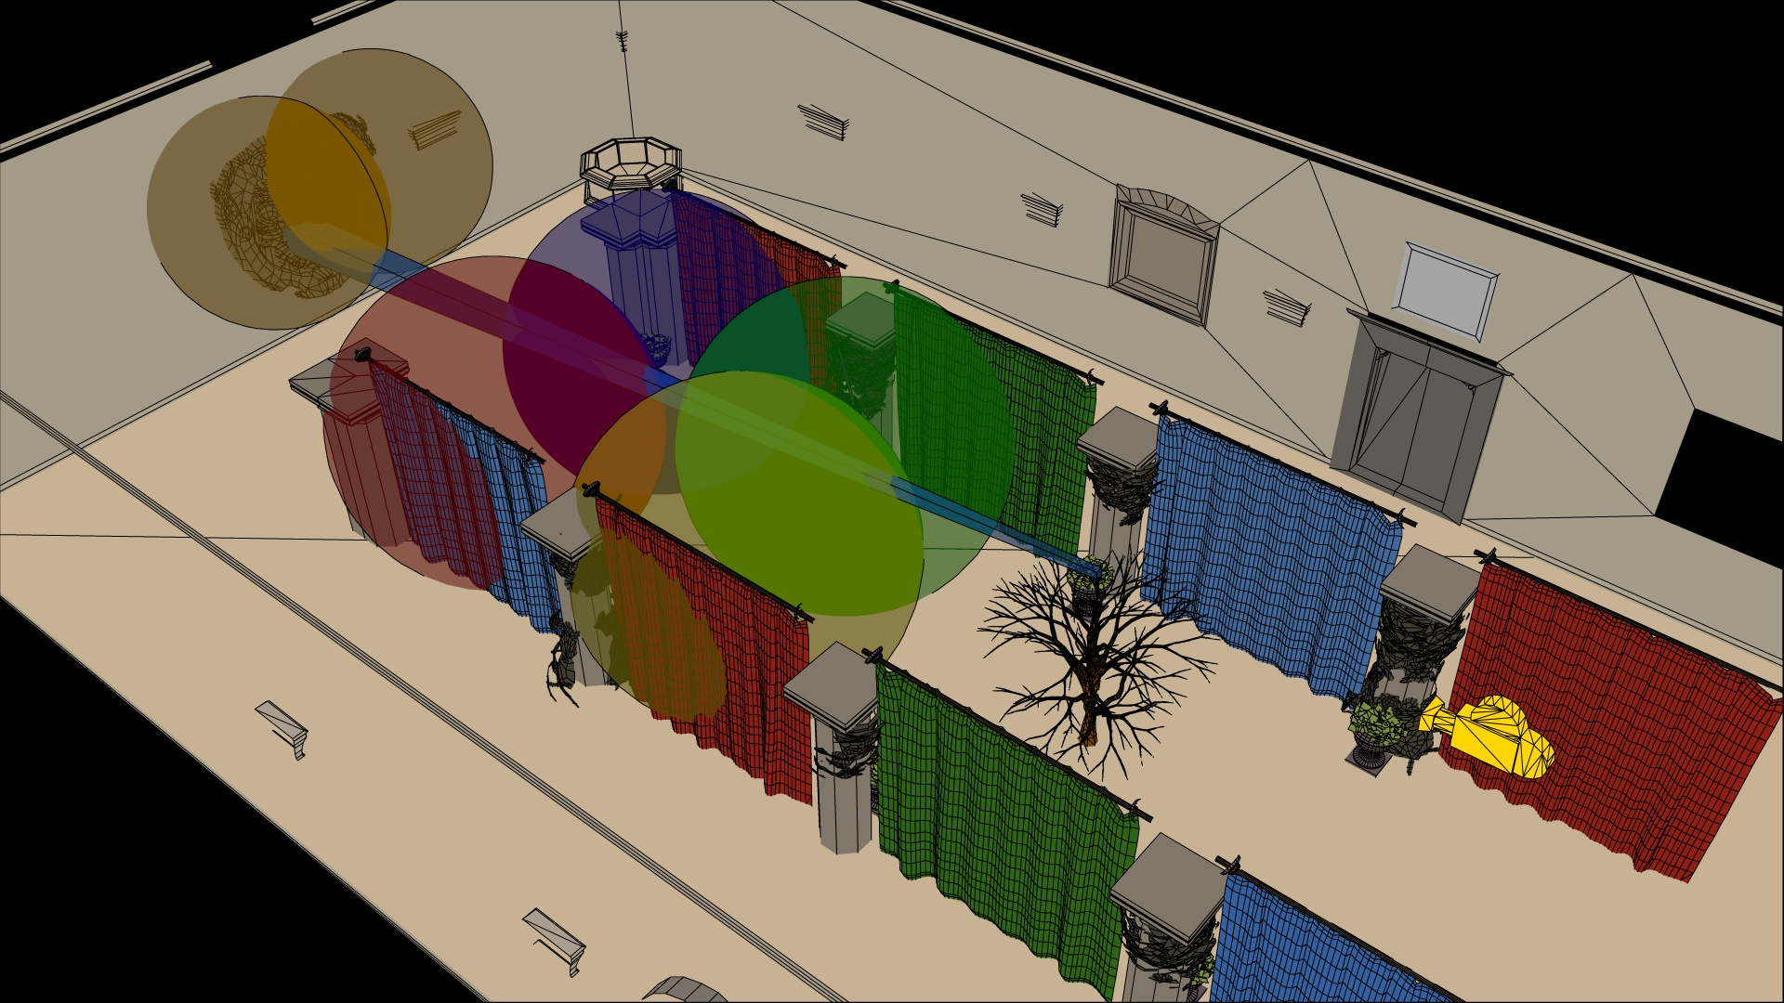
Tiled Shading - The Discontinuity Dysfunction
Notes:
In 3D the tile looks like this…

Slide 83
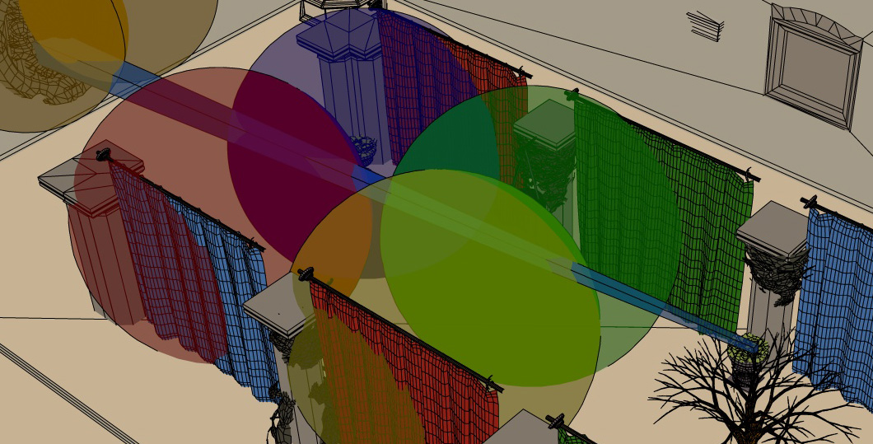
Tiled Shading - The Discontinuity Dysfunction

Slide 84
Tiled Shading - The Discontinuity Dysfunction
Intersects all 6 lights
Notes:
The tile extends from the tree through the visible scene to the wall.
This one troublesome tile intersects all 6 lights in our simple test scene.

Slide 85
Tiled Shading - The Discontinuity Dysfunction
Intersects all 6 lights
Notes:
While actually some of the samples, from the tree, are affected zero of these lights.

Slide 86
Tiled Shading - The Discontinuity Dysfunction
Intersects all 6 lights
Notes:
And the rest, would only need two of the lights.

Slide 87
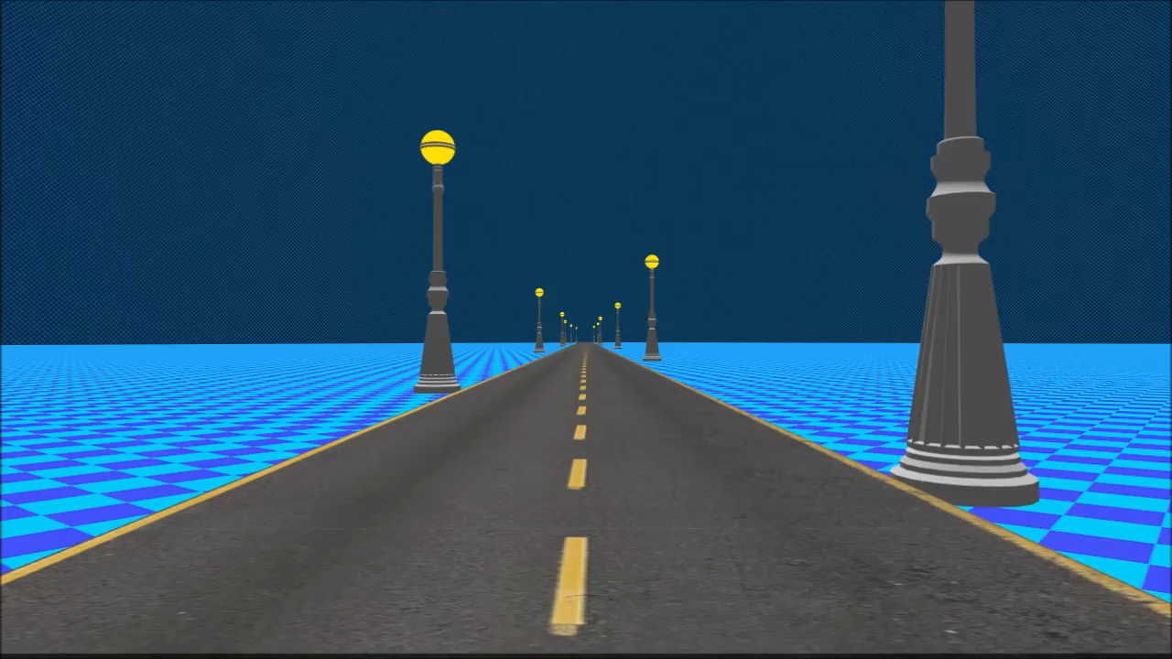
Troublesome Tiles

Slide 88
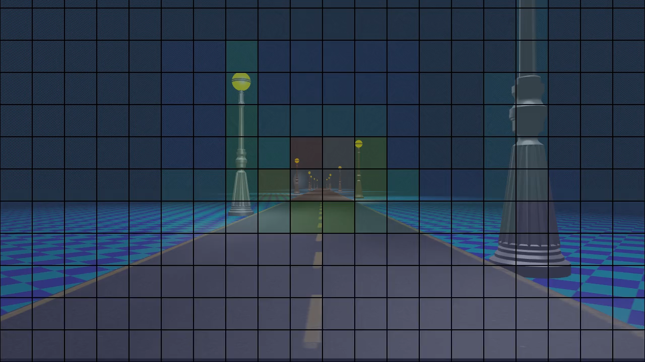
Troublesome Tiles
Notes:
So as we can see most of the trouble is around the light posts, where there are depth discontinuities.
And roads aren’t that uncommon in games I think.

Slide 89
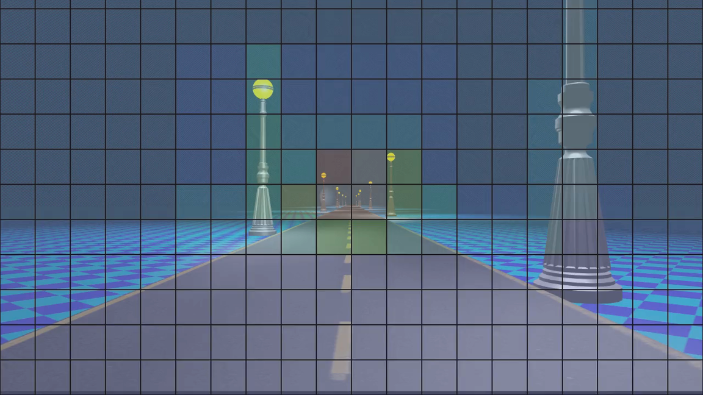
Troublesome Tiles
Notes:
* But, as if that is not bad enough, lest focus on this tile.

Slide 90
Troublesome Tiles
Flat Ground
No discontinuities!
Notes:
Zoomed in we see there is only flat ground, and no discontinuities.
So that should be a nice and good tile, right?

Slide 91
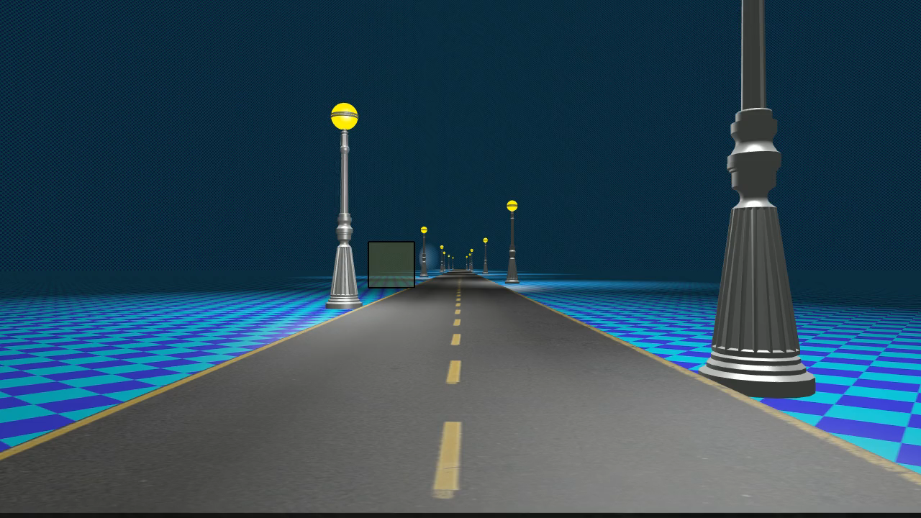
Troublesome Tiles
Notes:
Well, no! It is pretty darn long.
And I believe ground is something many games contain, so this might crop up here or there.

Slide 92
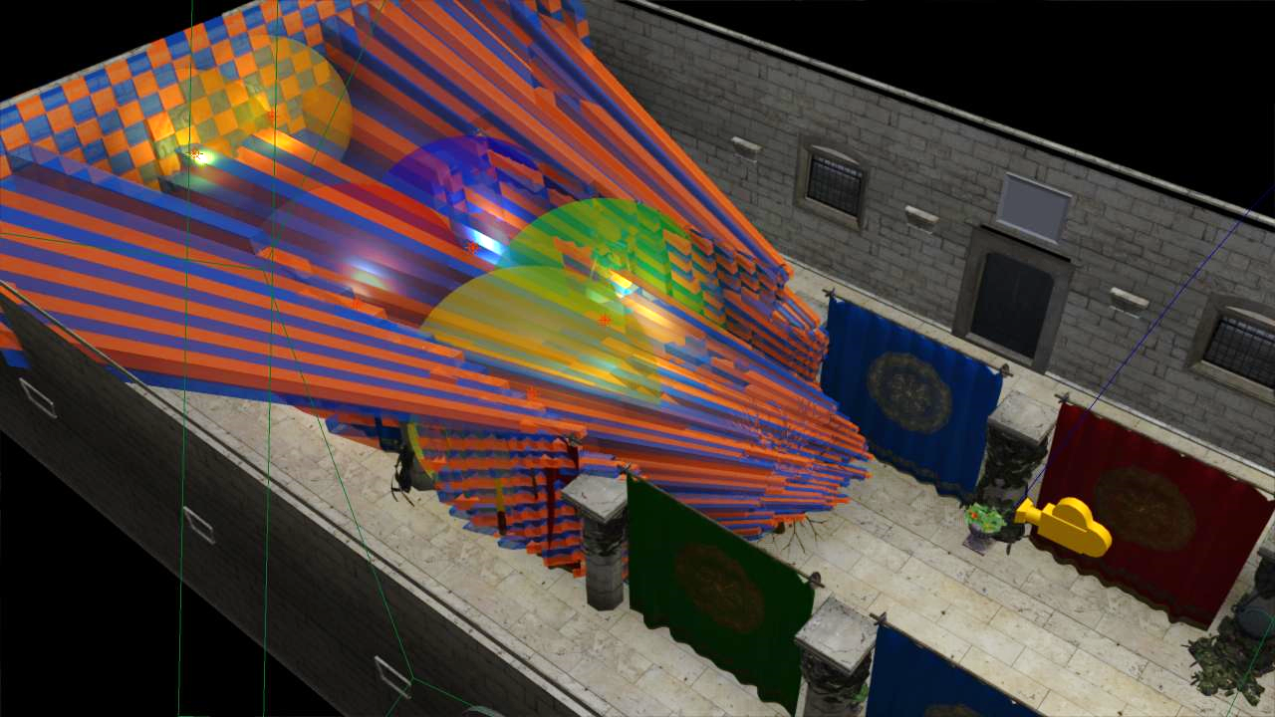
Tiled Shading
Tiles – 2D
Shading Points – 3D
  Fragments / Volumetric
Light density – 3D
View dependent
  Unpredictable shading times
Notes:
The problem stems from that we are making the intersection between lights and geometry samples, both of which are 3D entities, in a 2D screen space.
The main practical issue with this is that the resulting light assignment is highly view dependent. This means that we cannot author scenes with any strong guarantee on performance, as a given view of the scene may have a significantly higher screen space light density than average.
For example, we’d like to be able to construct a scene with, say, maximum 4 lights affecting any part of the scene. In this case, we would like shading cost to be proportional to this, and stable, given different view points. Unfortunately, no such correlation exists for tiled shading.
In other words shading times are unpredictable, which is a major problem for a real time application.
This simply had to be fixed, and in a way it stays fixed!
TODO: Illustrate view dependence using houses scene?

Slide 93
Tiled extensions
Attempts to address this problem
2.5D culling [Harada12]
’bimodal clusters’ / ‘HalfZ’ [Lauritzen12][Thomas15]
Notes:
Some techniques that mitigate this problem exists
I had to cull the slides describing how they work, but you can check out the GDC presentation by Gareth Thomas, where they are explained very well.

Slide 94
2.5D culling [Harada12]
Tile
Z-max
Tile
Z-min
Y
Eye
near
Notes:
Some techniques that attempts to address this exists
One is 2.5D culling, which

Slide 95
2.5D culling [Harada12]
Tile
Z-max
Bit mask in depth direction
Tile
Z-min
Y
Eye
Tile Mask:
1
0
0
0
0
0
0
1
near
Notes:
Some techniques that attempts to address this exists
One is 2.5D culling, which

Slide 96
2.5D culling [Harada12]
Light
Z-min
Light
Z-max
Bit mask in depth direction
And for light
Y
Eye
Tile Mask:
1
0
0
0
0
0
0
1
Light Mask:
near
0
0
1
1
1
1
0
0
Notes:
Some techniques that attempts to address this exists
One is 2.5D culling, which

Slide 97
2.5D culling [Harada12]
Light
Z-min
Light
Z-max
Bit mask in depth direction
And for light
Binary AND
  Discard if no
  overlap
Y
Eye
Tile Mask:
1
0
0
0
0
0
0
1
Light Mask:
near
0
0
1
1
1
1
0
0
&
=
0
0
0
0
0
0
0
0
Notes:
This takes care of some lights overlapping empty space.

Slide 98
’bimodal clusters’ / ‘HalfZ’ [Lauritzen12][Thomas15]
Tile
Z-max
Tile
Z-mid
Split Depth Range
Separate light lists
Tile
Z-min
Y
Eye
near
Notes:
Some techniques that attempts to address this exists
One is 2.5D culling, which

Slide 99
’bimodal clusters’ / ‘HalfZ’ [Lauritzen12][Thomas15]
Tile
Z-max
Split Depth Range
Separate light lists
‘Modified HalfZ’
  Shrink to fit
Basically two clusters
Tile
Z-min
Y
Eye
near
Notes:
Some techniques that attempts to address this exists
One is 2.5D culling, which

Slide 100
Tiled extensions
Problems
  Lack of generality: Slopes / multiple layers
  No solution for transparency
  Require depth pre-pass
Notes:
In summary, these techniques lack generality, and don’t really handle slopes.
Also they both require a pre-existing depth buffer, and thus do not support transparency.

Slide 101
Clustered Shading
Clustered Deferred, Clustered Forward
Notes:
This brings us to the second of the modern techniques, clustered shading.
It is squarely aimed at addressing this problem, and making sure it stays solved.
~25 - 28

Slide 102
Clustered Shading – Key Idea
near_{k}
far_{k}
Add the 3rd dimension
  Tile also in depth direction
Cluster
  Groups related samples
Y
h_{k}
Z
d_{k}=h_{k}
near
far
Notes:
Clustered shading can be seen as a generalization of tiled shading, and can be said to cover pretty much any way of
grouping of related sample points.
For what we’re interested in, this relation pretty much boils down to 3D Euclidean distance.
which means that they are nearby in space.<click>

Slide 103
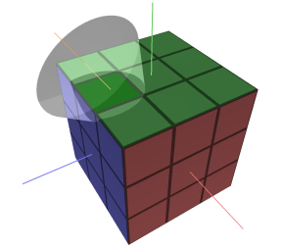
Clustered Shading – Key Idea
near_{k}
far_{k}
Add the 3rd dimension
  Tile also in depth direction
Cluster
  Groups related samples
  Also > 3 dimensions (e.g. normals) [Olsson12a]
  Or other attributes…
Y
h_{k}
Z
d_{k}=h_{k}
near
far
Notes:
But we could cluster in yet higher dimensions, for example based on normal direction…<click>
…or on completely different attributes, like reflectance.
But here we’ll focus on 3D position, and we don’t use any fancy k-means clustering algorithm (though that would be interesting)
But simply bin the view frustum into grid cells – you may have heard the term froxels, this is pretty much the same.

Slide 104
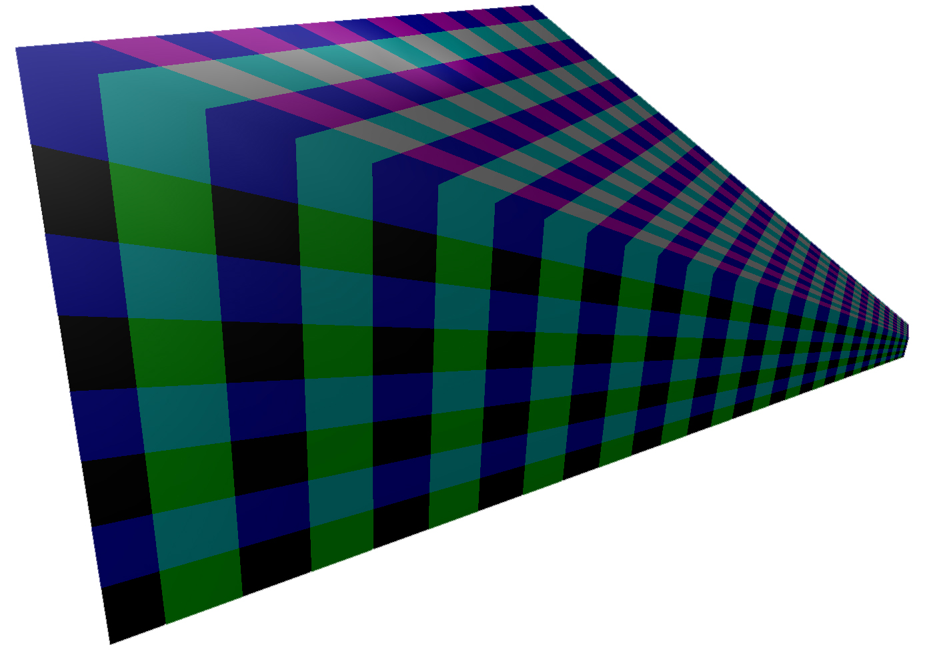
Clustered Shading Properties
3D subdivisions
  Bounded volume around samples
    Shading cost ~ Light density.
Notes:
So by doing 3D subdivisions we get a much more localized and consistent volume around each group of samples.
Which enables a correlation between light density in the scene and the run time shading cost.
This is important for control and predictability of performance.
Lets take a look at how it works out using the road example from before.

Slide 105
Troublesome Tiles
Notes:
Recall the tiles.

Slide 106
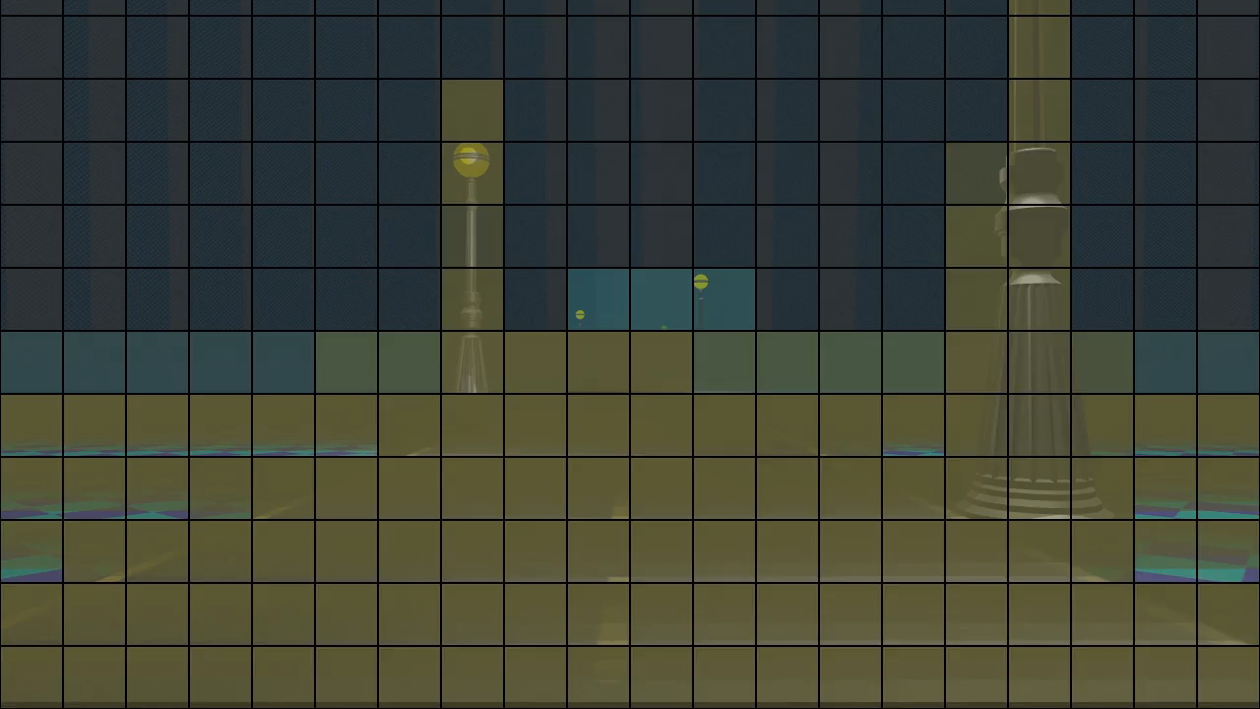
Nice Clusters
Notes:
And here the same view, but with clusters.
As we can see, the clusters will overlap only a few lights each
And follow the scene geometry well.

Slide 107
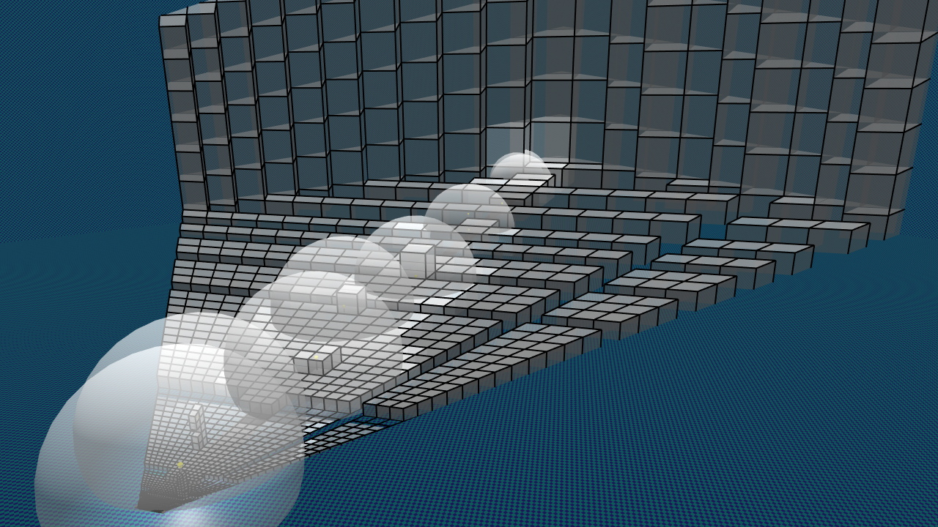
Nice Clusters
Notes:
And here the same view, but with clusters.
As we can see, the clusters will overlap only a few lights each
And follow the scene geometry well.

Slide 108
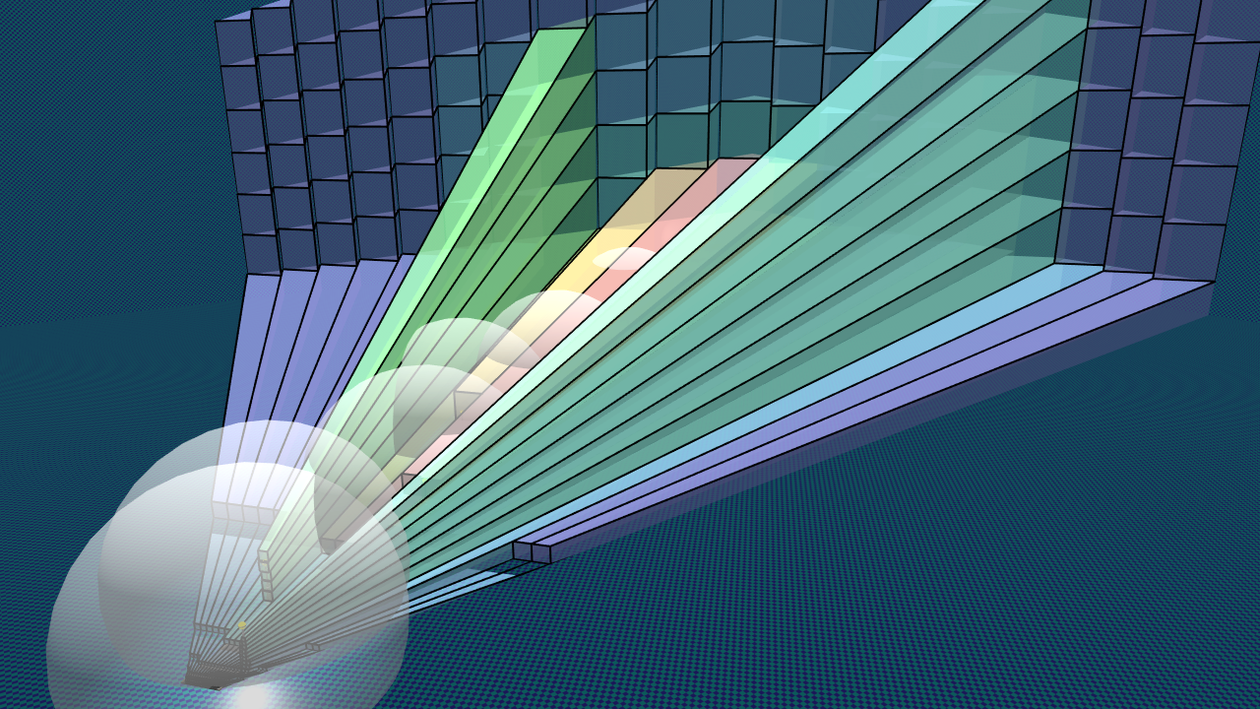
Troublesome Tiles
Notes:
Going back to the tiles, it looks like this…

Slide 109
Cluster key / index
near_{k}
far_{k}
Cluster key:
  ck = (i, j, k) integer tuple
i, j = 2D tile id
  gl_FragCoord.xy
k = ≈log(view space z)
Y
Z
near
far
Notes:
So, a bit more detail on how we actually build our clusters?
The original scheme from the paper, though you will see a couple of modifications later, is to use regular subdivision starting from 2D tiles,
which provides the i and j coordinates.
While k is a logarithmic function of the view space Z of the sample, not simply the logarithm, for the exact equation see the paper.
This defines a 3D grid within the view volume. <click>

Slide 110
Cluster key / index
near_{k}
far_{k}
Cluster key:
  ck = (i, j, k) integer tuple
i, j = 2D tile id
  gl_FragCoord.xy
k = ≈log(view space z)
Y
h_{k}
Z
d_{k}=h_{k}
near
far
Notes:
The logarithmic subdivision creates self similar clusters that are as cube like as possible.
This means that as clusters become larger further away, we get a kind of LOD behavior and do not end up with insane numbers of clusters far away, for a wide range of view parameters.

Slide 111
Light Assignment
Clusters
  Proxy for visible geometry
    Bounds view samples
      3D boxes
    Orders of magnitudes
    fewer
Lights
  Bounding spheres/cones
  Cluster/Light Pairs
    Links overlapping clusters and lights
Geometry
Occupied Cluster
C₀
Y
L₀
C₁
-Z
Eye
L₁
C₂
Near
C₃
far
Notes:
Light assignment, just like for tiled shading, is finding the overlap between lights and clusters…
and recording this in a list per cluster.
We will cover some concrete approaches to this later in the course.

Slide 112
Full-Screen Clustered Shading Pass
Color
Normal
Light Grid:
L₀
L₁
L₂
L₃
L₄
L₅
L₆
…
0
0
6
3
0
6
4
4
…
Position(Z)
Specular
out vec4 resultColor;
void main()
{
vec3 color = texelFetch(colorTex, gl_FragCoord);
vec3 specular= texelFetch(specularTex, gl_FragCoord);
vec3 normal = texelFetch(normalTex, gl_FragCoord);
vec3 position = fetchPosition(gl_FragCoord);
vec3 shading = accumulate for each light in cluster;
resultColor = vec4(shading, 1.0);
}
Light Grid:
0
1
4
7
offset
1
3
3
1
66
67
69
…
size
1
2
2
…
…
…
Notes:
The shading pass then is virtually identical to tiled shading.
The only difference is how to calculate the index into the light grid and lookup the light list.
So we clearly have the same benefits in memory bandwidth.

Slide 113
Variations on a Theme
Sparse vs. Dense Cluster Grid
Explicit vs. Implicit Clusters
Deferred vs. Forward
Hierarchical Clusters or not
Supporting transparency
Notes:
So that was the super high level overview of clustered shading.
Now lets try to look at some of the important design decisions you can pick when implementing it.

Slide 114
Sparse vs. Dense Cluster Grid
Sparse Cluster Grid
  Only store cells that contain samples
  Requires Pre(-Z) pass / Deferred
  No redundant light assignment
  Geometry info useful for other things!
Dense Cluster Grid
  Must assign lights to all clusters
  Can be done on CPU / Asynchronously
  Can access any point in view volume
  SAME shading cost as for sparse!

Slide 115
Explicit vs. Implicit Clusters
Explicit cluster bounds
  Actual bounding box of samples
  Some storage
  Some cost to build
  Tight bounds
  Extra geometry pass for forward shading
Implicit cluster bounds
  Implied by grid coordinate
  No storage
  Can have large empty space.

Slide 116
Deferred vs. Forward Shading
No fundamental decision
  Easy to change
Deferred
  Easier to support sparse grid
Forward
  MSAA, Transparency
  Vary shading model
Both
  Deferred for opaque
  Forward for transparent
  Same or separate grids

Slide 117
Cluster Hierarchy
Cheap to build [Sintorn14]
Hierarchical representation of visible samples.
Enables novel techniques
  Efficient Shadow Volumes
  Shadow maps (Talk #3)
  Splatting in general.

Slide 118
Transparent Geometry
Tiled Forward Shading [Olsson12b]
  Extend tile Z bounds
    To Min Z
    Or Near plane
Y
Eye
Z
near
far
Notes:
It’s simple to support transparent geometry with tiled forward shading.
For example by finding the min and max Z values, or just extending tiles to the near plane.
However…

Slide 119
Transparent Geometry
Tiled Forward Shading [Olsson12b]
Problems
  View dependent
  Degenerates to 2D
  Full screen discontinuity!
Y
Eye
Z
near
far
Notes:
The result of transparent geometry covering the view is effectively the loss of the depth range optimization
which can be a very bad thing™.
Again, the biggest issue here is that it is view dependent, and so will only be possible to determine at run time
and, as we all know, this kind of problem usually starts showing up five minutes after we shipped a build to the publisher.

Slide 120
Clustered Forward Shading [Olsson12b]
Dense cluster grid
  Just works!
Sparse cluster grid
  Pre-geometry pass.
  Flag used clusters.
    Side effect in
    fragment shader.
    Set cell flag to one.
Y
Eye
Z
near
far
Notes:
Clustered Shading does not suffer from this problem, as each cluster represents a fixed section of 3D space.
The only problem we face is trying to determine what clusters are need such that we can assign lights to them.
This can be done by rendering a pre-pass with the transparent geometry.
This can be performed after a regular G-buffer or pre-z pass, with color and depth writes turned off, and sets the used clusters to one as a side effect in the fragment shader.
The algorithm is otherwise as before.
Note that clustered shading provides an efficient way to solve the light assignment problem for any transparency technique, not just good old order dependent transparency.

Slide 121
End!
Notes:
~37 - 40

Slide 122
Technique Comparison
 | Trad. Deferred | Tiled Deferred | Tiled Forward | Clustered Deferred | Clustered Forward
Bandwidth Use | High | Low | Low | Low | Low
Transparency | No | With Fwd → | Yes | With Fwd → | Yes
MSAA | Maybe | Maybe | Yes | Maybe | Yes
Shadow Map reuse | Yes | No | No | No | No
Geometry Passes | 1 | 1 | 1-2* | 1 | 1-2⁺
Register Pressure | Low | High | High | High | High
Innermost loop | Pixels | Lights | Lights | Lights | Lights
FB Precision | High | Low | Low | Low | Low
View dependence | Low# | High | High | Low | Low
Vary Shading Models | Hard | Hard | Simple | Hard | Simple
Notes:
Footnotes:
*: Depends on whether pre-z pass is used, which is pretty much require if the scene has any depth complexity
+: 1 Pass is generally fine if a dense grid is used. Then a pre-z pass is only used to prime depth buffer for overdraw handling.
#: If the stencil buffer optimization is NOT used (and perhaps it is not practical today) then view dependence might be quite high because of light overdraw!

Slide 123
References
[Persson13] Practical Clustered Deferred and Forward Shading, Persson & Olsson 2013, http://advances.realtimerendering.com/s2013
[Olsson12a] Clustered Deferred and Forward Shading, Olsson et.al. 2012
[Olsson12b] Tiled and Clustered Forward Shading, Olsson et.al. 2012
[Valient14] Reflections and volumetrics of Killzone Shadow Fall , SIGGRAPH’14, http://advances.realtimerendering.com/s2014
[Andersson14] Rendering Battlefield 4 with Mantle, GDC 2014
[Shulz14] Moving to the Next Generation - The Rendering Technology of Ryse, GDC 2014.
[Tebbs92] Brice Tebbs, Ulrich Neumann, John Eyles, Greg Turk, and David Ellsworth. Parallel architectures and algorithms for real-time synthesis of high quality images using deferred shading. 1992.
[Saito90] Takafumi Saito and Tokiichiro Takahashi. Comprehensible rendering of 3-d shapes. SIGGRAPH Comput. Graph., 24(4):197–206, 1990.
[Hargreaves04] Shawn Hargreaves and Mark Harris. Deferred shading. NVIDIA Developer Conference: 6800 Leagues Under the Sea, 2004.
[Shishkovtsov05] Oles Shishkovtsov. Deferred shading in S.T.A.L.K.E.R. In GPU Gems 2. Addison-Wesley, 2005.
[Arvo03] Jukka Arvo and Timo Aila. Optimized shadow mapping using the stencil buffer. JGT, 8(3):23–32, 2003.
[Harada12] A 2.5D culling for forward+. In SIGGRAPH Asia 2012 Technical Briefs, ACM, 18:1–18:4.
[Lauritzen12] Andrew Lauritzen, Intersecting Lights with Pixels, In SIGGRAPH 2012 Courses, Beyond Programmable Shading,
[Ferrier11] Alex Ferrier and Christina Coffin, Deferred shading techniques using frostbite in "Battlefield 3" and "Need for Speed the Run“, SIGGRAPH 2011 Talks
[Sintorn14] Erik Sintorn , Viktor Kämpe , Ola Olsson and Ulf Assarsson, Per-Triangle Shadow Volumes Using a View-Sample Cluster Hierarchy, I3D 2014
[Trebilco07] Damian Trebilco, 2007 (Shader X7 2009), GitHub: https://github.com/dtrebilco/lightindexed-deferredrender
Papers / Slides / Demo implementation with source: http://www.cse.chalmers.se/~olaolss

Slide 124
References
[Persson13] , Persson & Olsson 2013, http://advances.realtimerendering.com/s2013
[Olsson12a] Clustered Deferred and Forward Shading, Olsson et.al. 2012
[Olsson12b] Tiled and Clustered Forward Shading, Olsson et.al. 2012
[Valient14] Reflections and volumetrics of Killzone Shadow Fall , SIGGRAPH’14, http://advances.realtimerendering.com/s2014
[Andersson14] Rendering Battlefield 4 with Mantle, GDC 2014
[Shulz14] Moving to the Next Generation - The Rendering Technology of Ryse, GDC 2014.
[Fauconneau14] Marc Fauconneau Dufresne, Intel, Forward Clustered Shading, https://software.intel.com/en-us/articles/forward-clustered-shading
http://www.cse.chalmers.se/~olaolss

